Slide 1
包装设计
AI

Slide 2
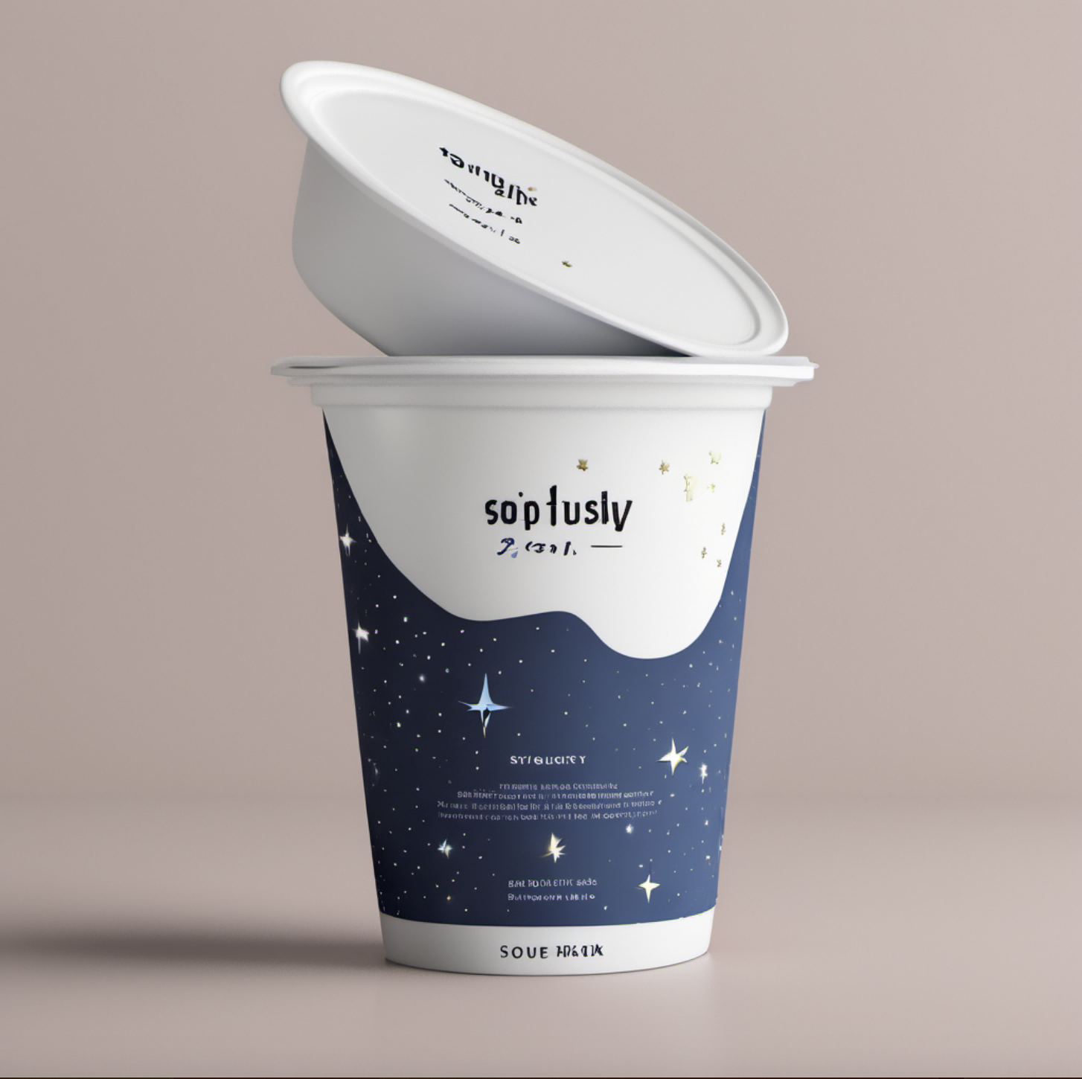
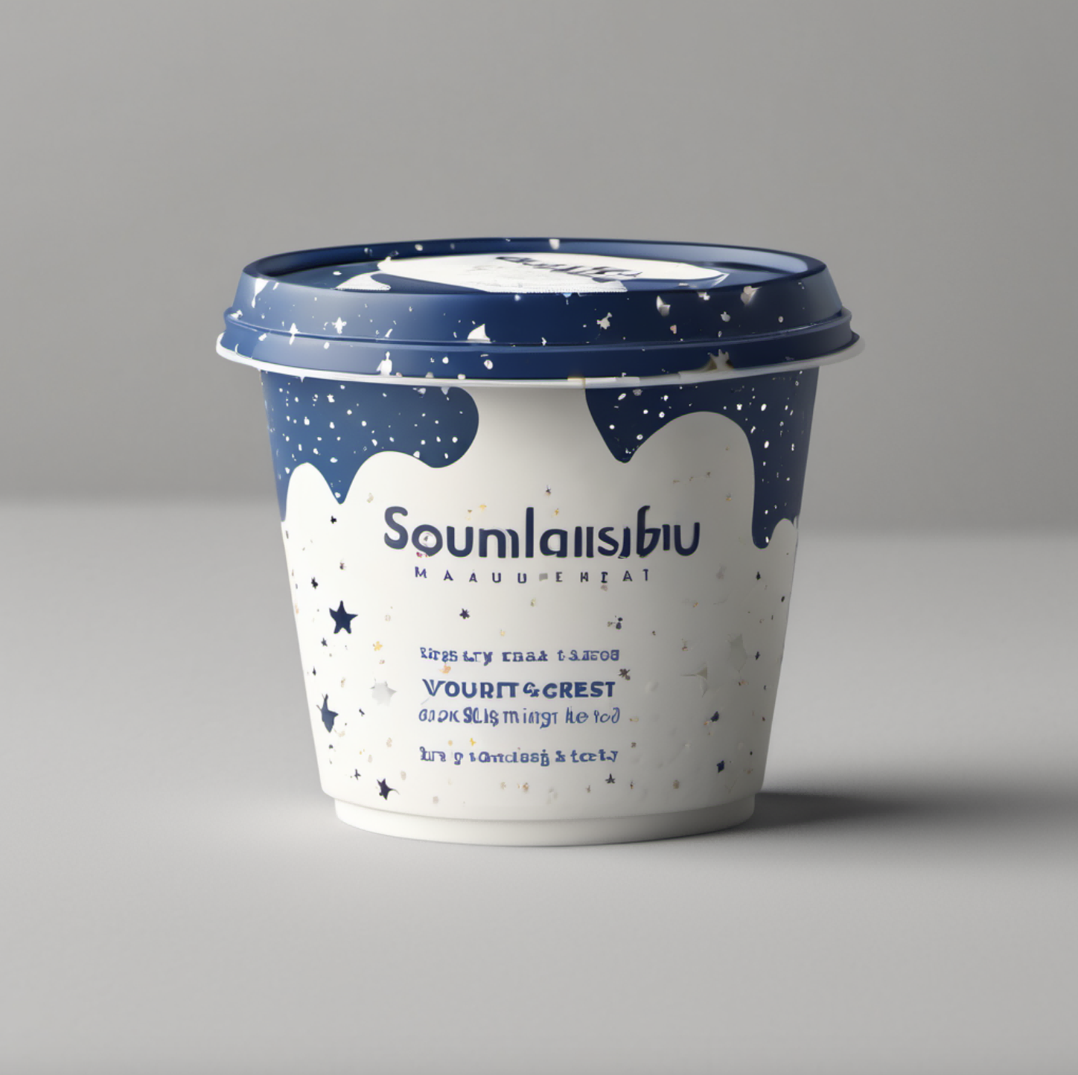
SDXL模型
prompt：yoghurt packaging,minimalism,starry sky”（酸奶包装，极简主义，星空）

Slide 3
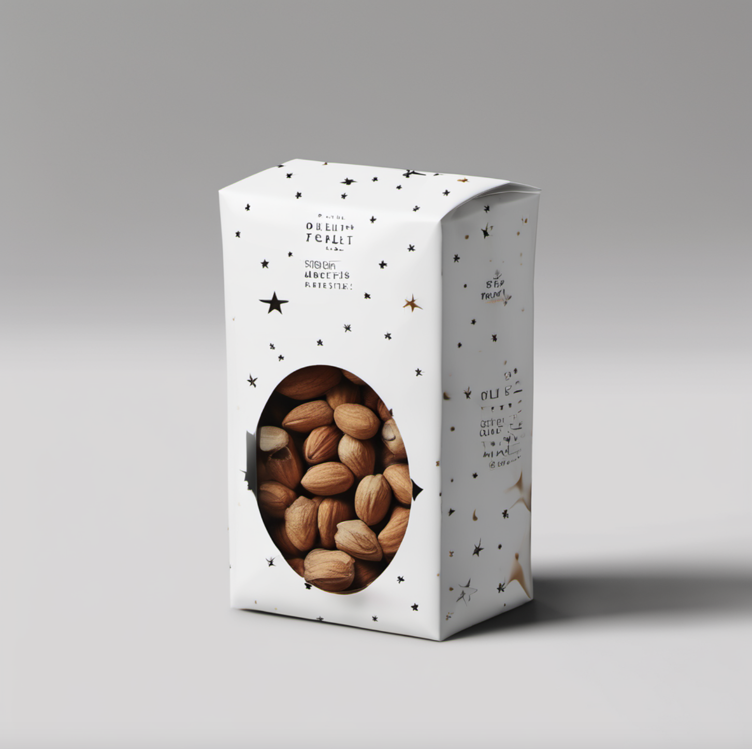
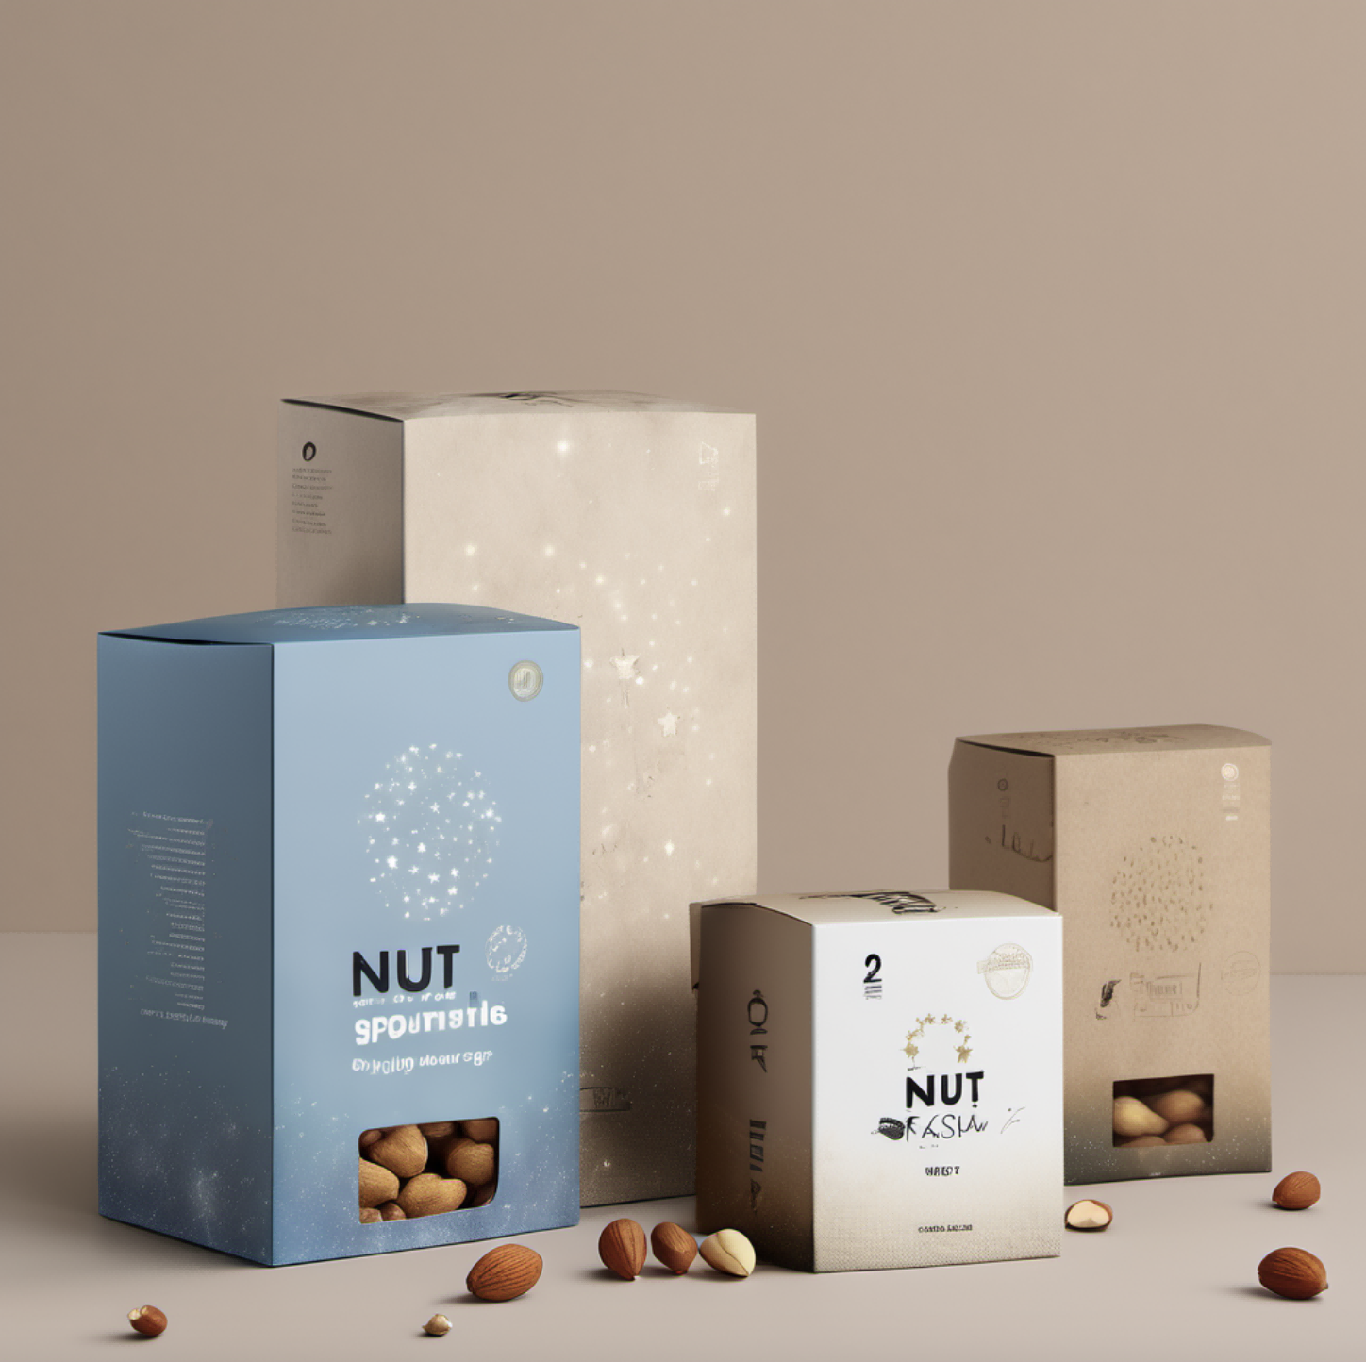
直接生成：SDXL模型
prompt：nut packaging,minimalism,starry sky”（坚果包装，极简主义，星空）

Slide 4
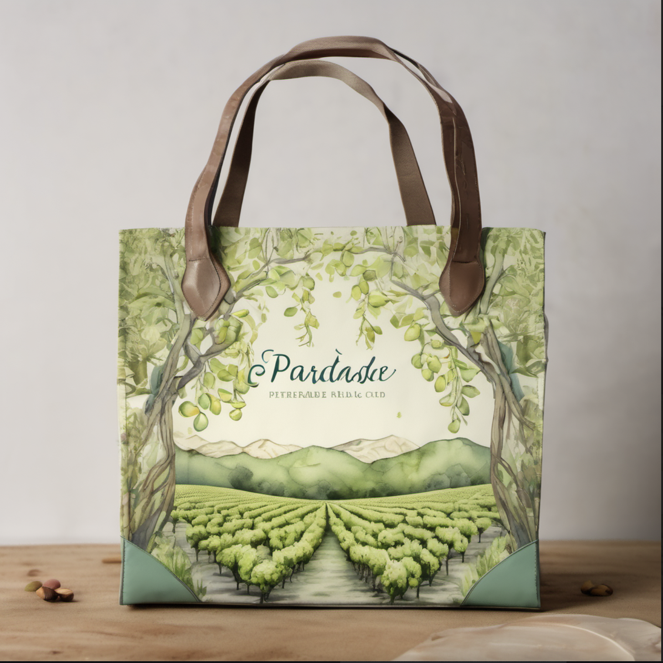
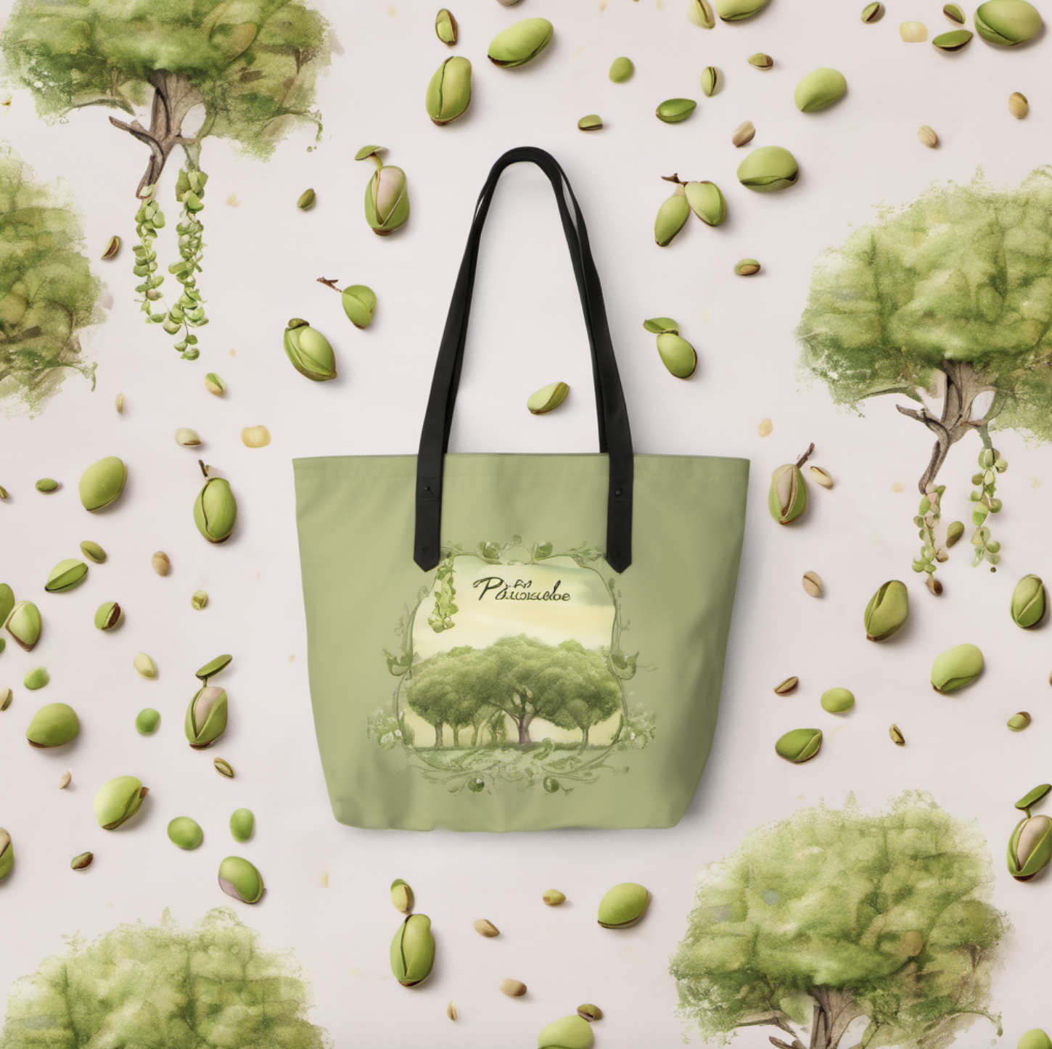
SDXL模型：开心果产品包装设计
AIGC 助手：开心果产品包装设计
prompt1：A whimsical and artistic design featuring a dreamy pistachio orchard scene. The bag showcases a watercolor-style illustration of pistachio trees, with the words "Pistachio Paradise" intertwined with delicate vines and leaves.
一个奇幻而艺术的设计，展现了一个梦幻的开心果果园场景。包装袋上有一幅水彩风格的开心果树插图，配以“开心果天堂”字样，与精致的藤蔓和叶子交织在一起。

Slide 5
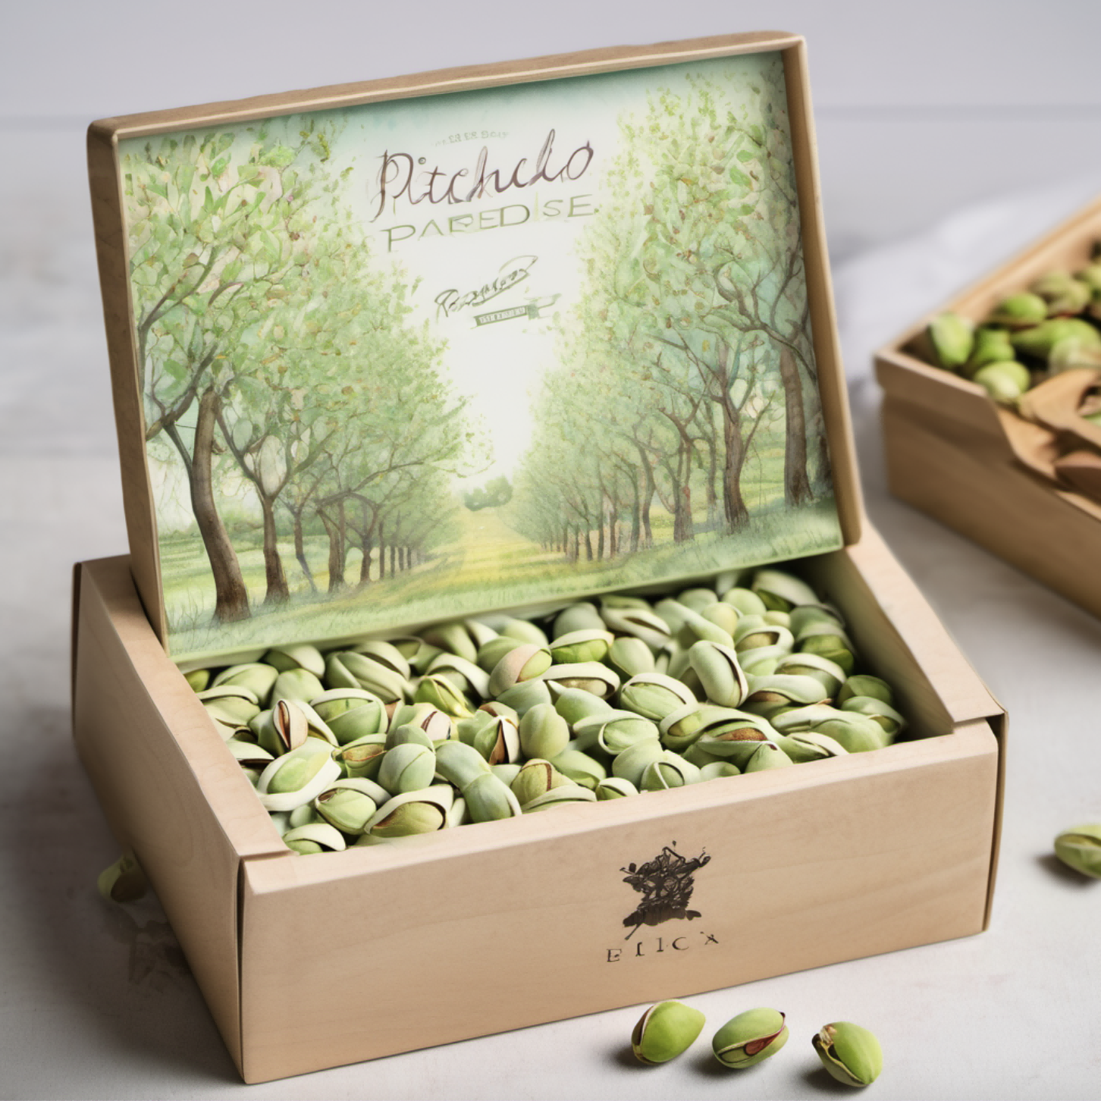
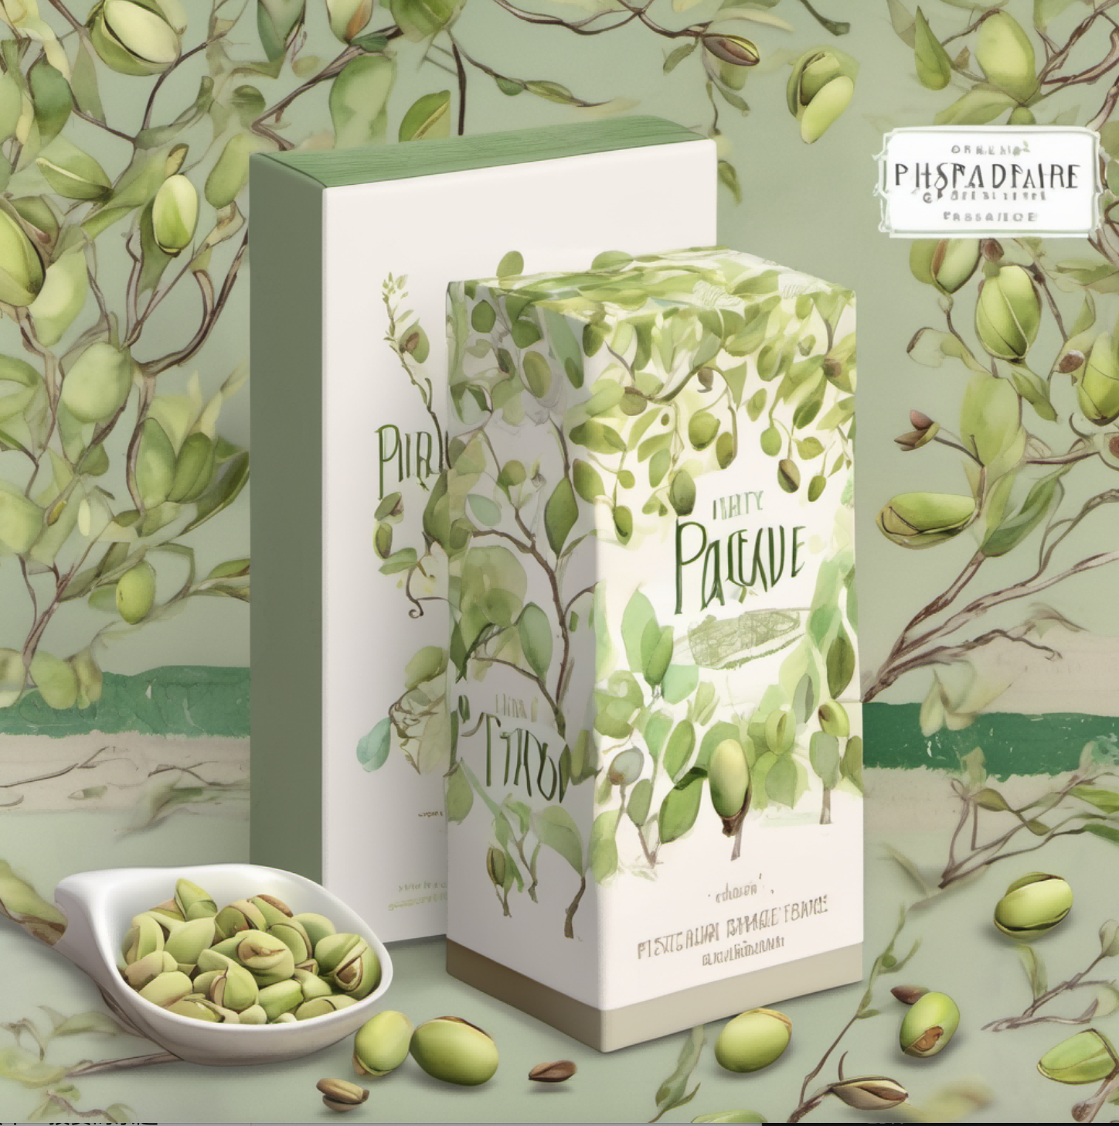

Slide 6
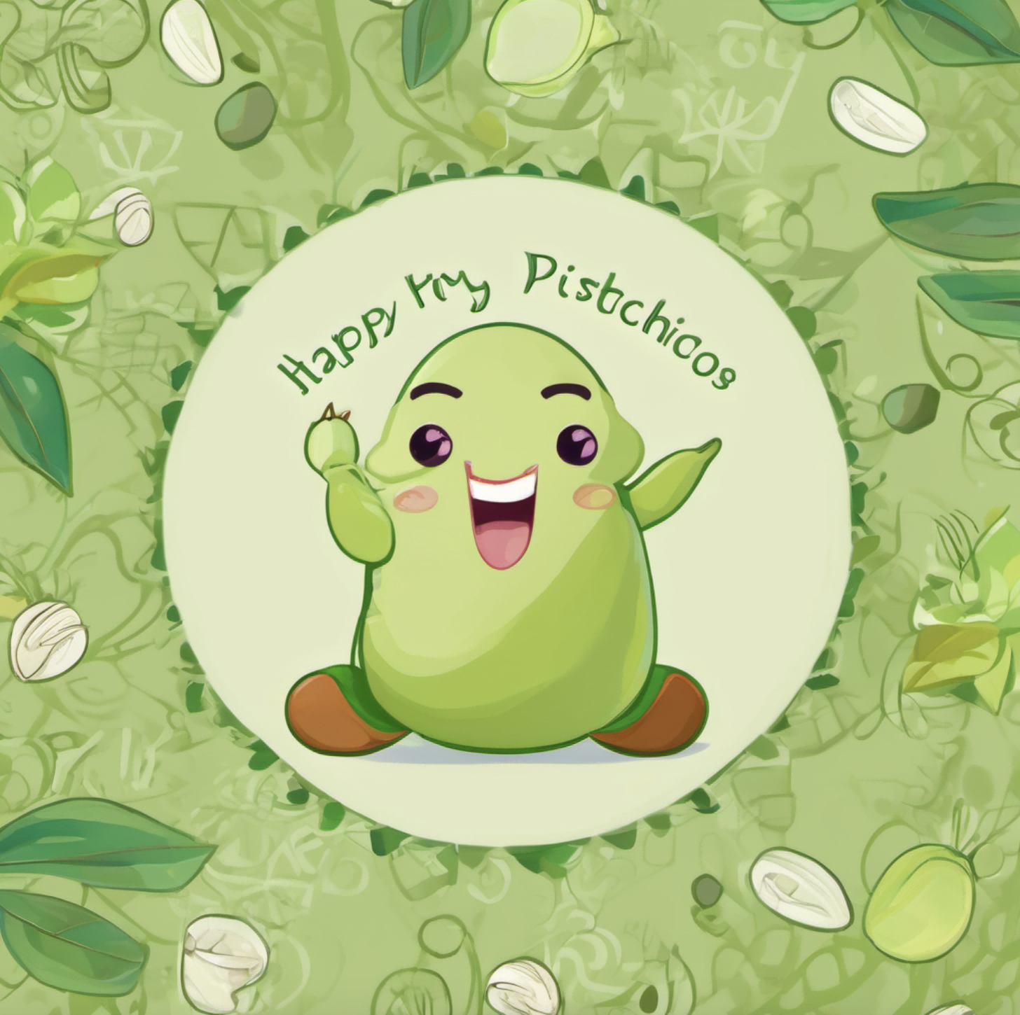
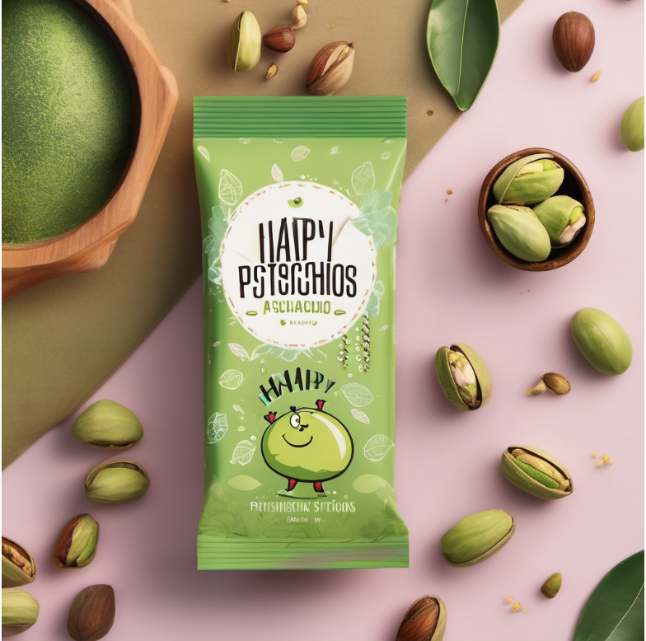
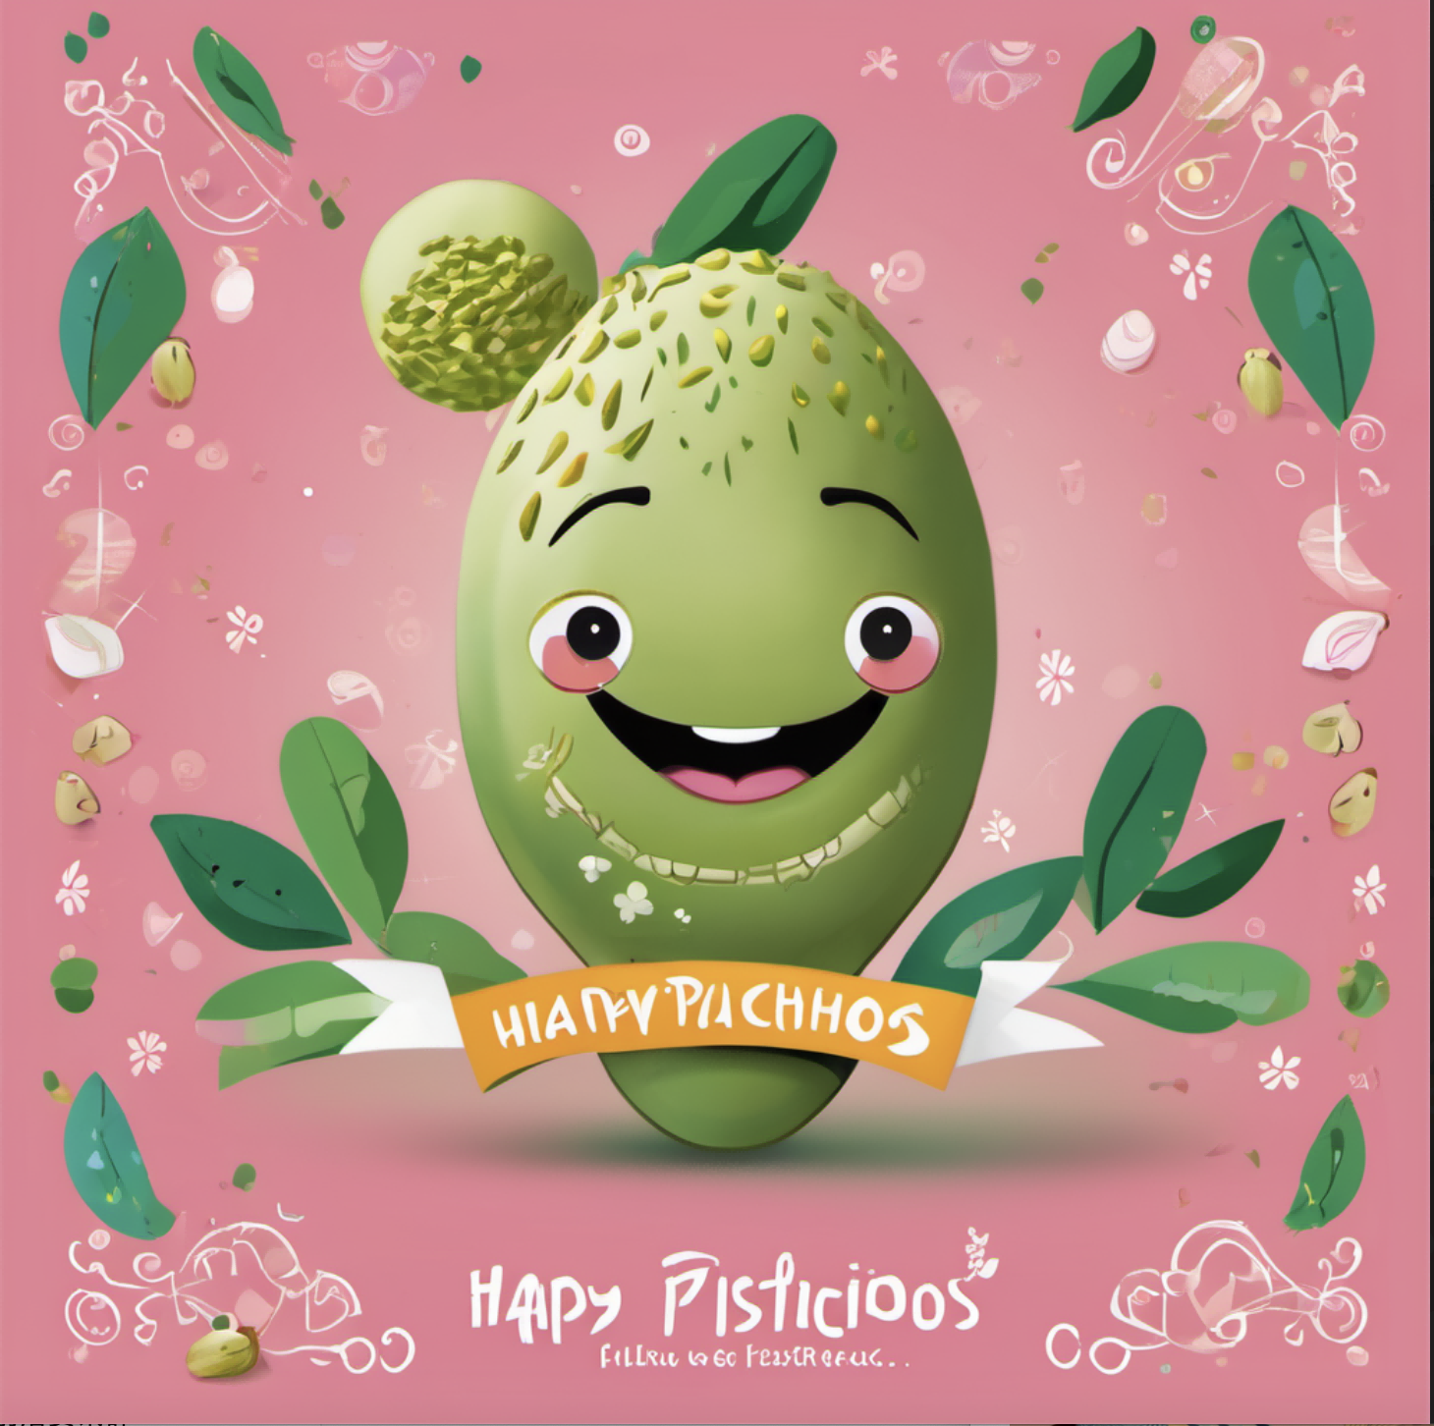
直接生成：SDXL模型
AIGC 助手：开心果产品包装设计
prompt2：A vibrant and playful design featuring a cheerful pistachio character surrounded by a burst of greenery. The background is adorned with whimsical patterns and the words "Happy Pistachios" in a fun, inviting font.
一个充满活力和俏皮的设计，有一个愉快的开心果角色，周围是一片翠绿的绿色植物。背景装饰着奇妙的图案，用一种有趣、引人入胜的字体写着“开心果”。

Slide 7
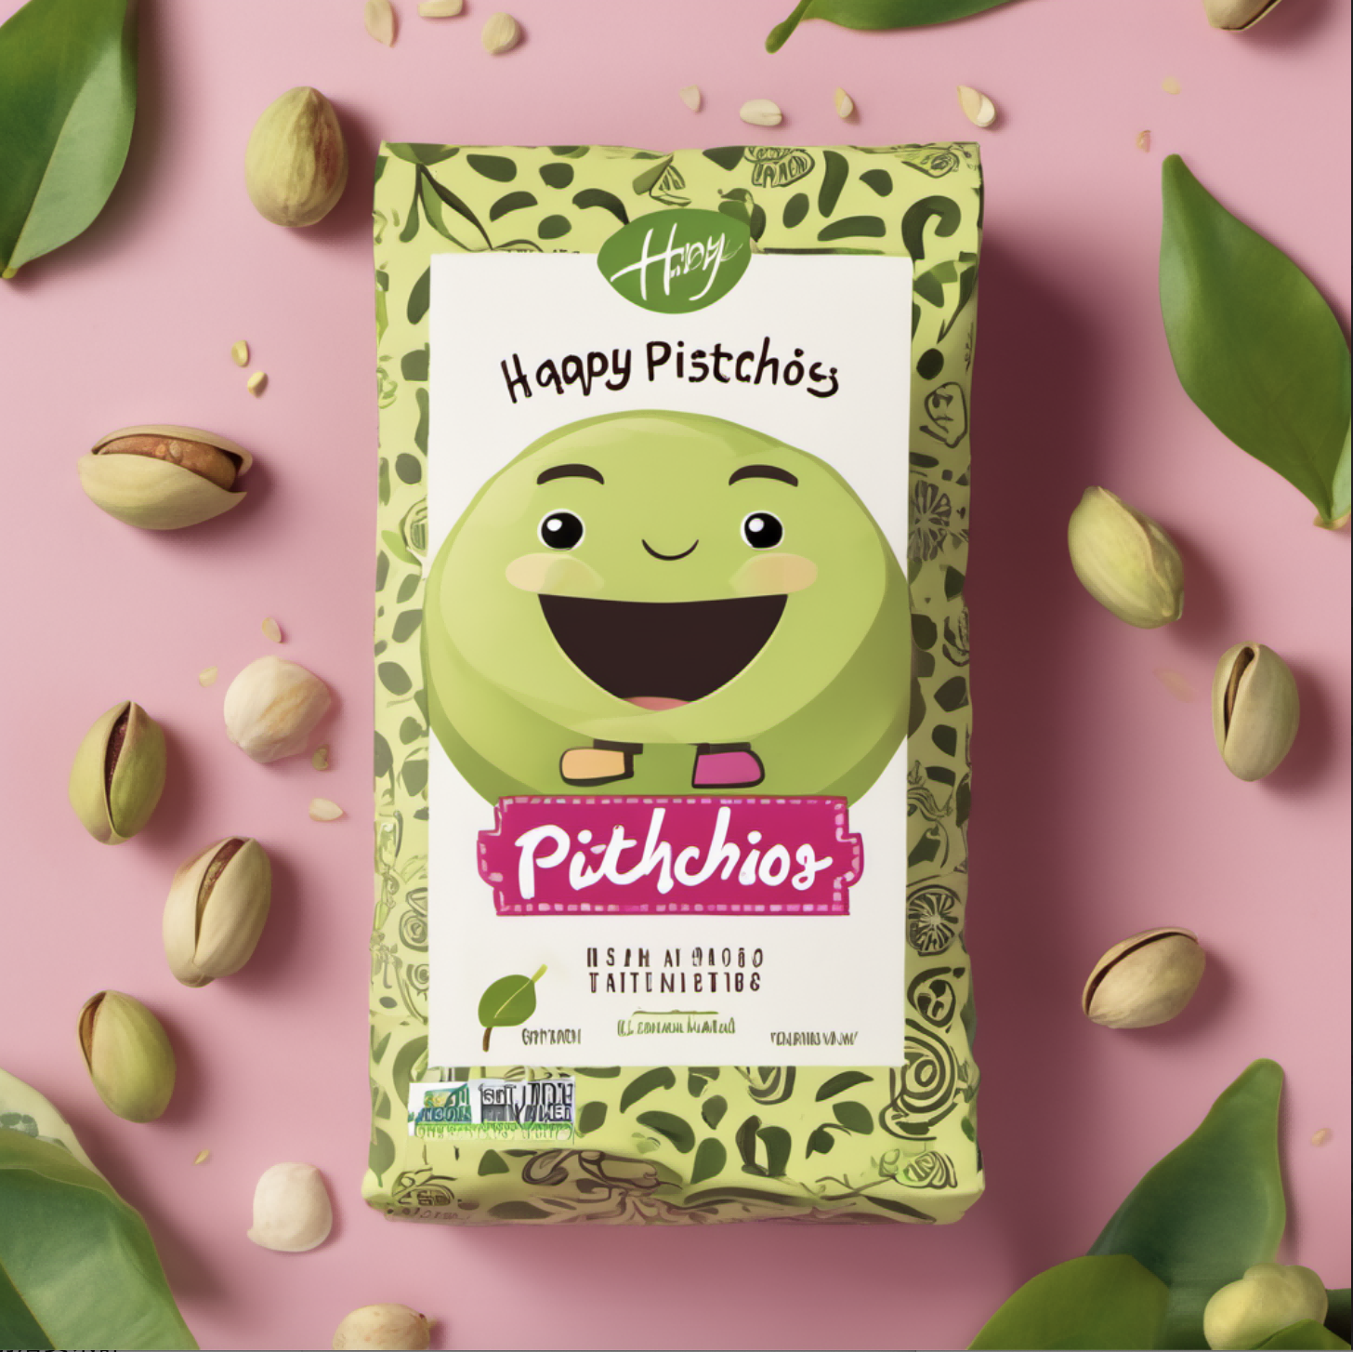
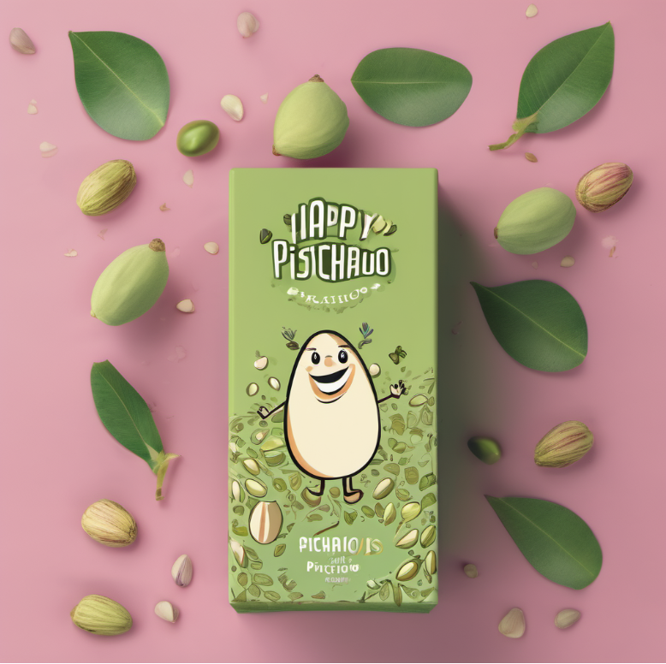
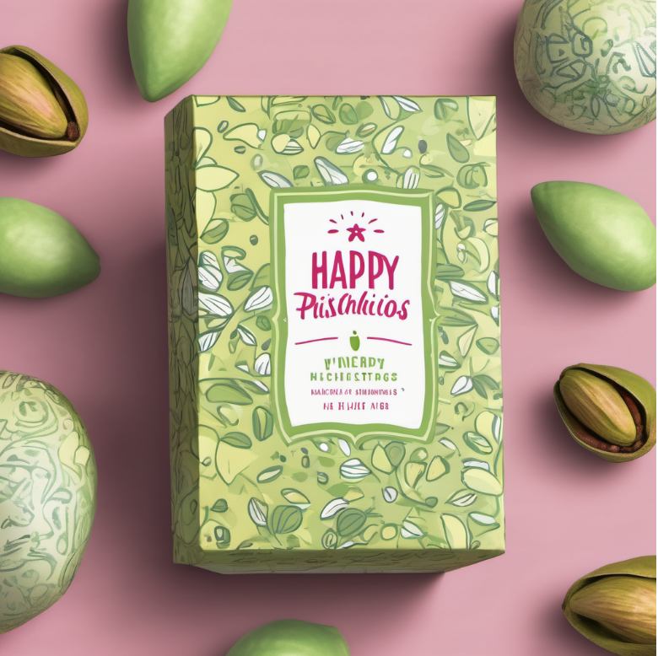
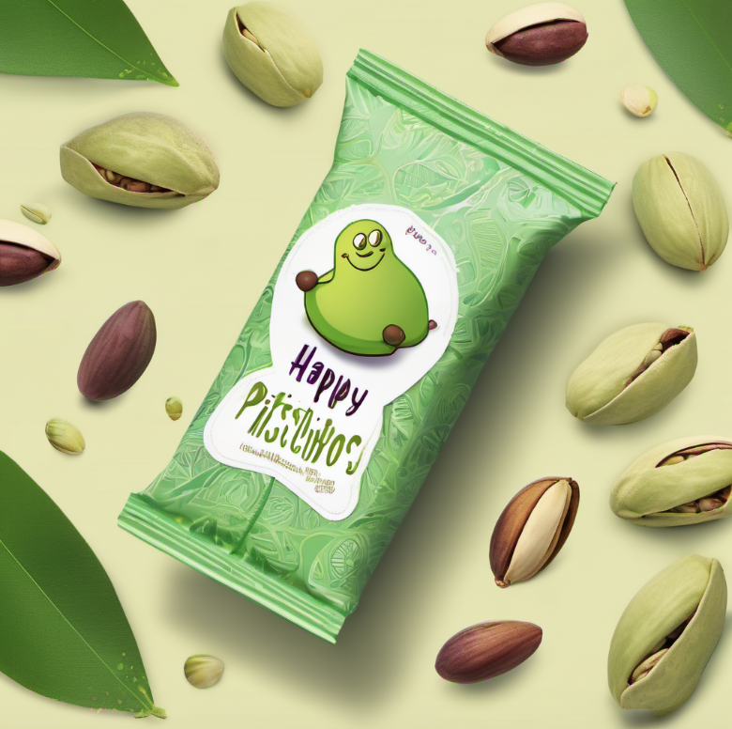
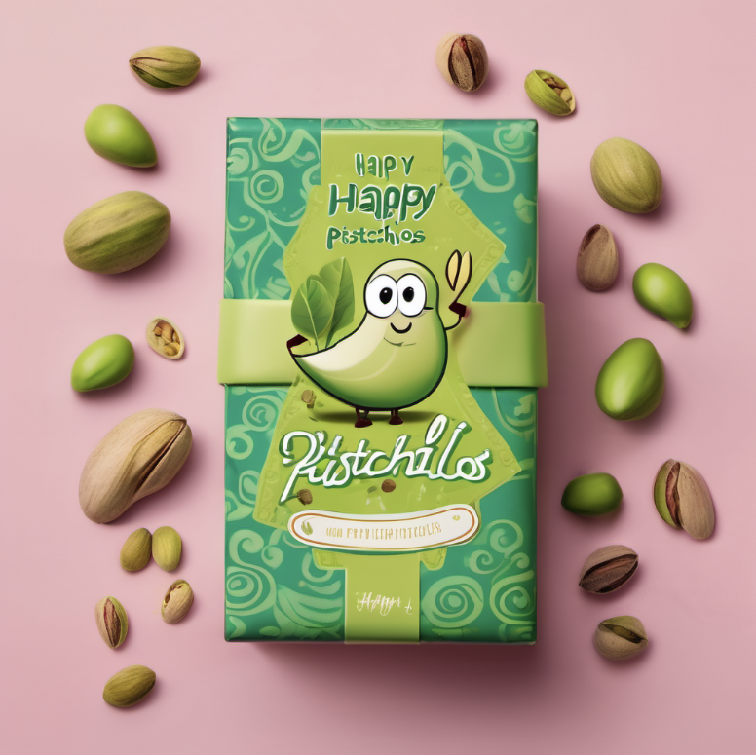
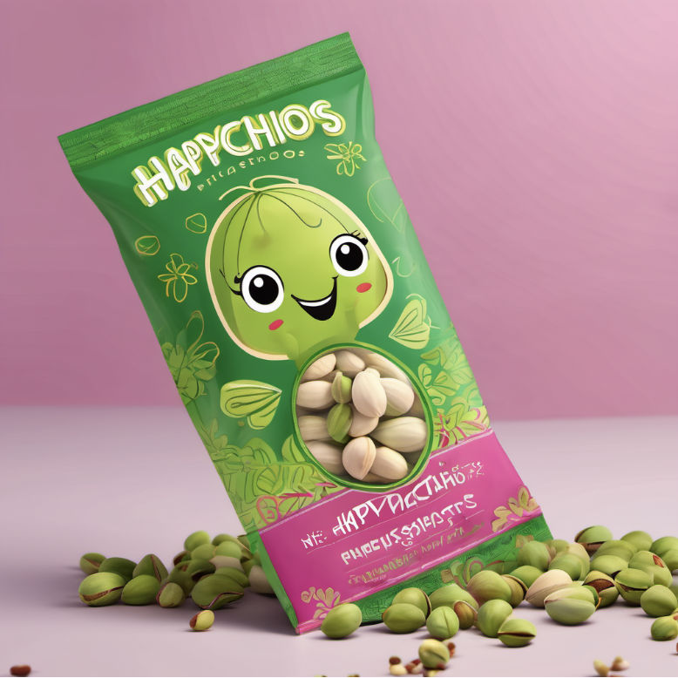

Slide 8
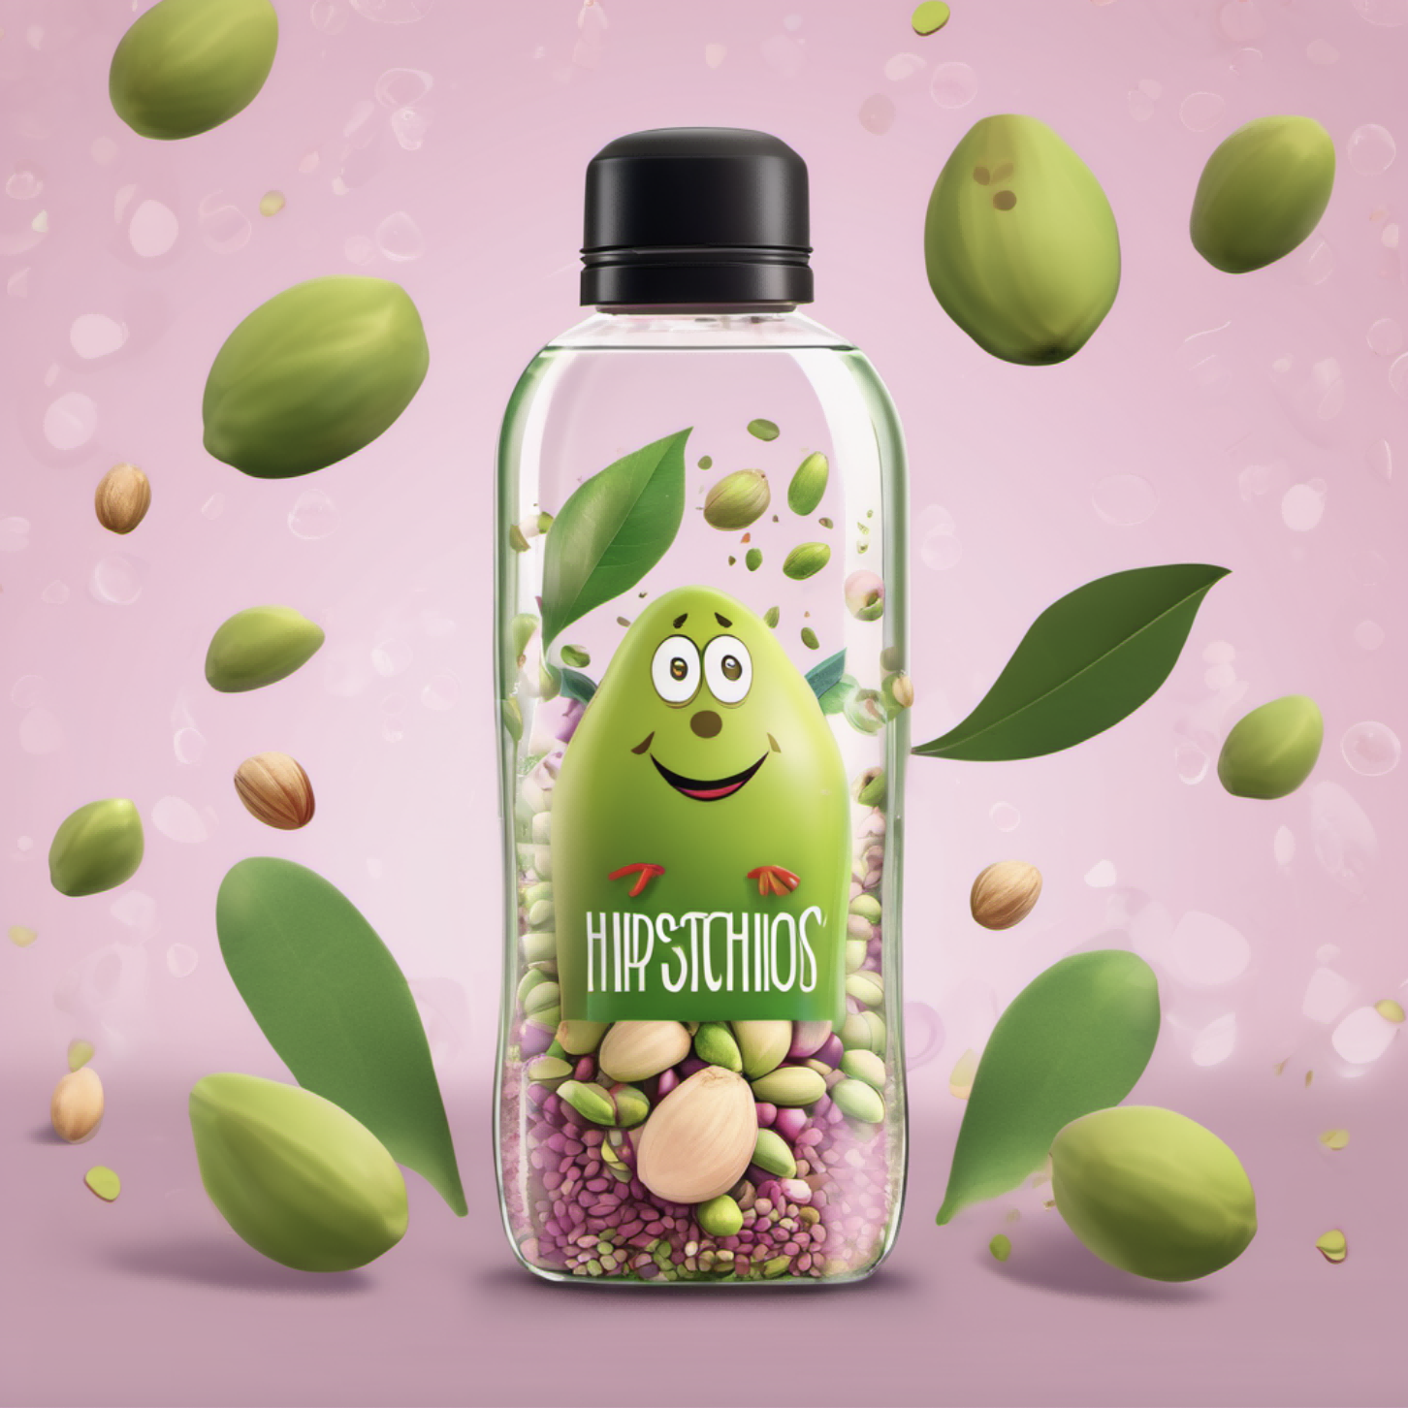
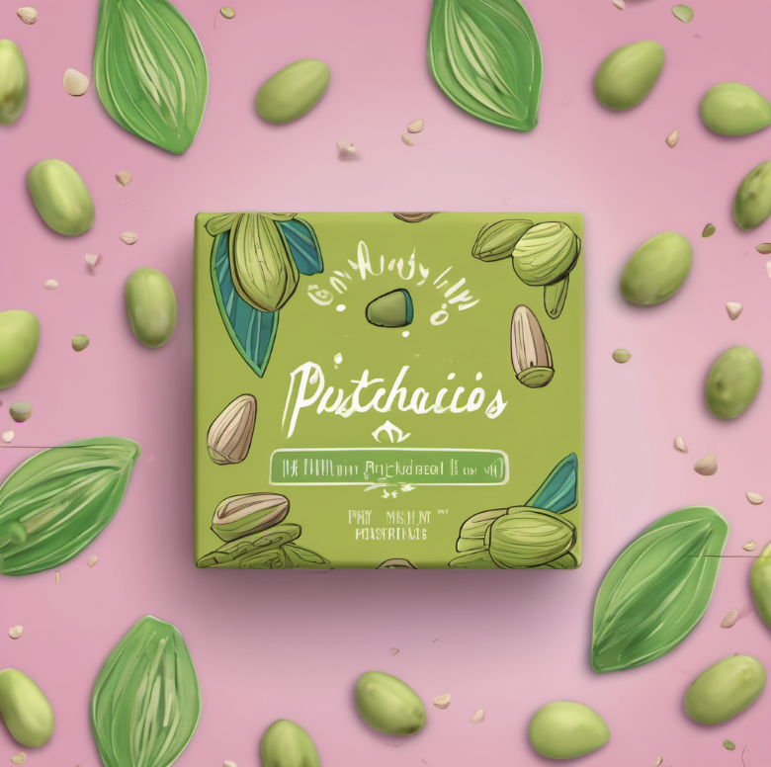
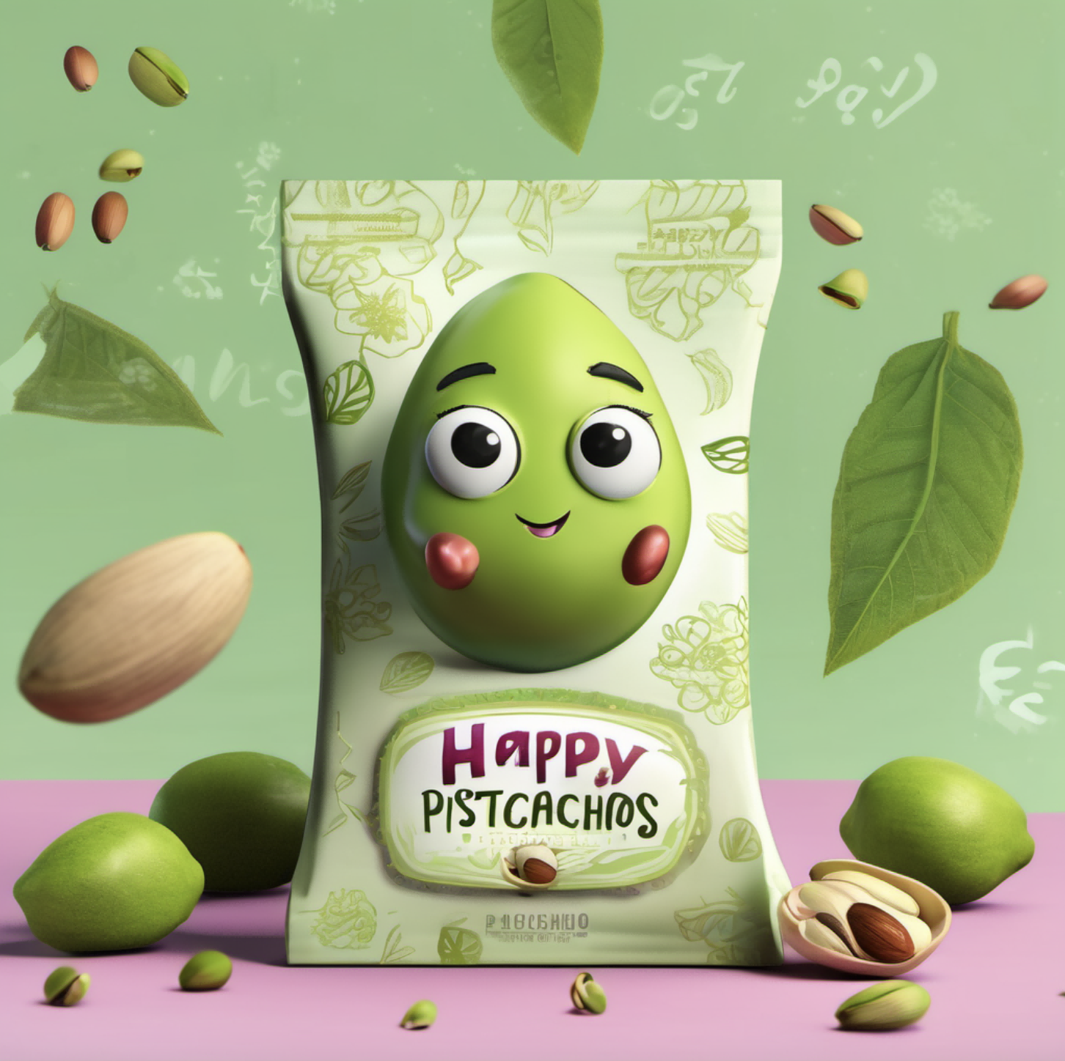
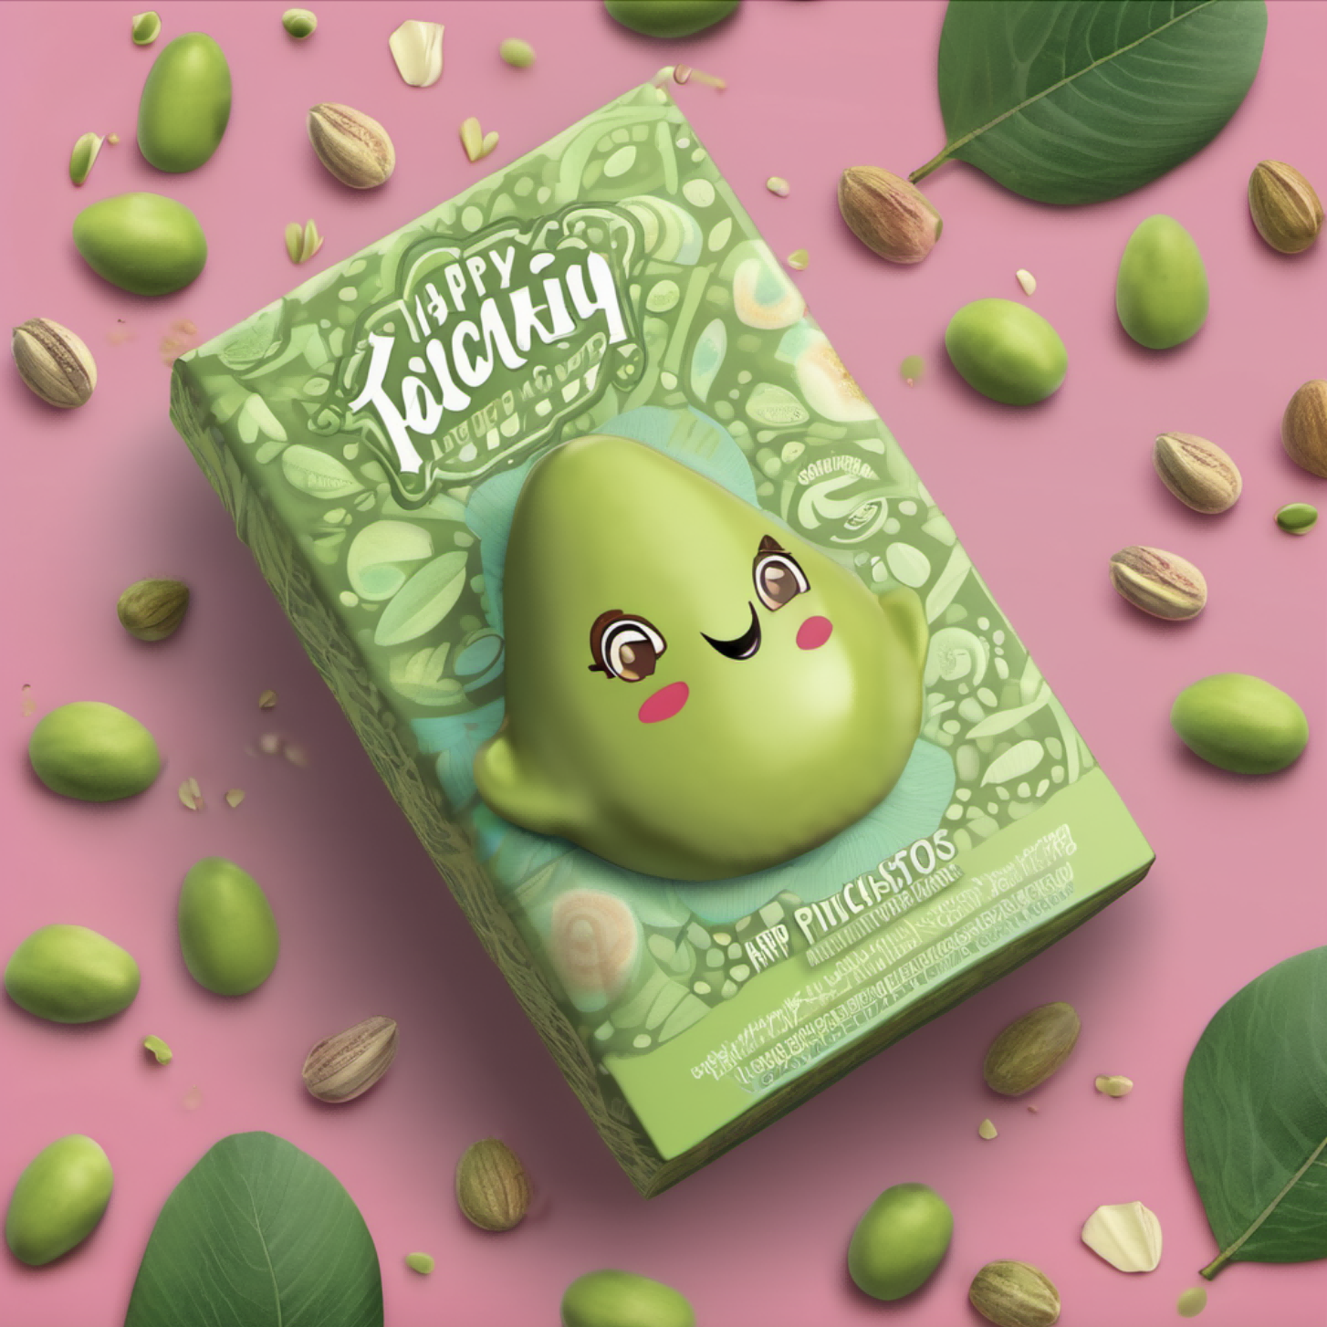
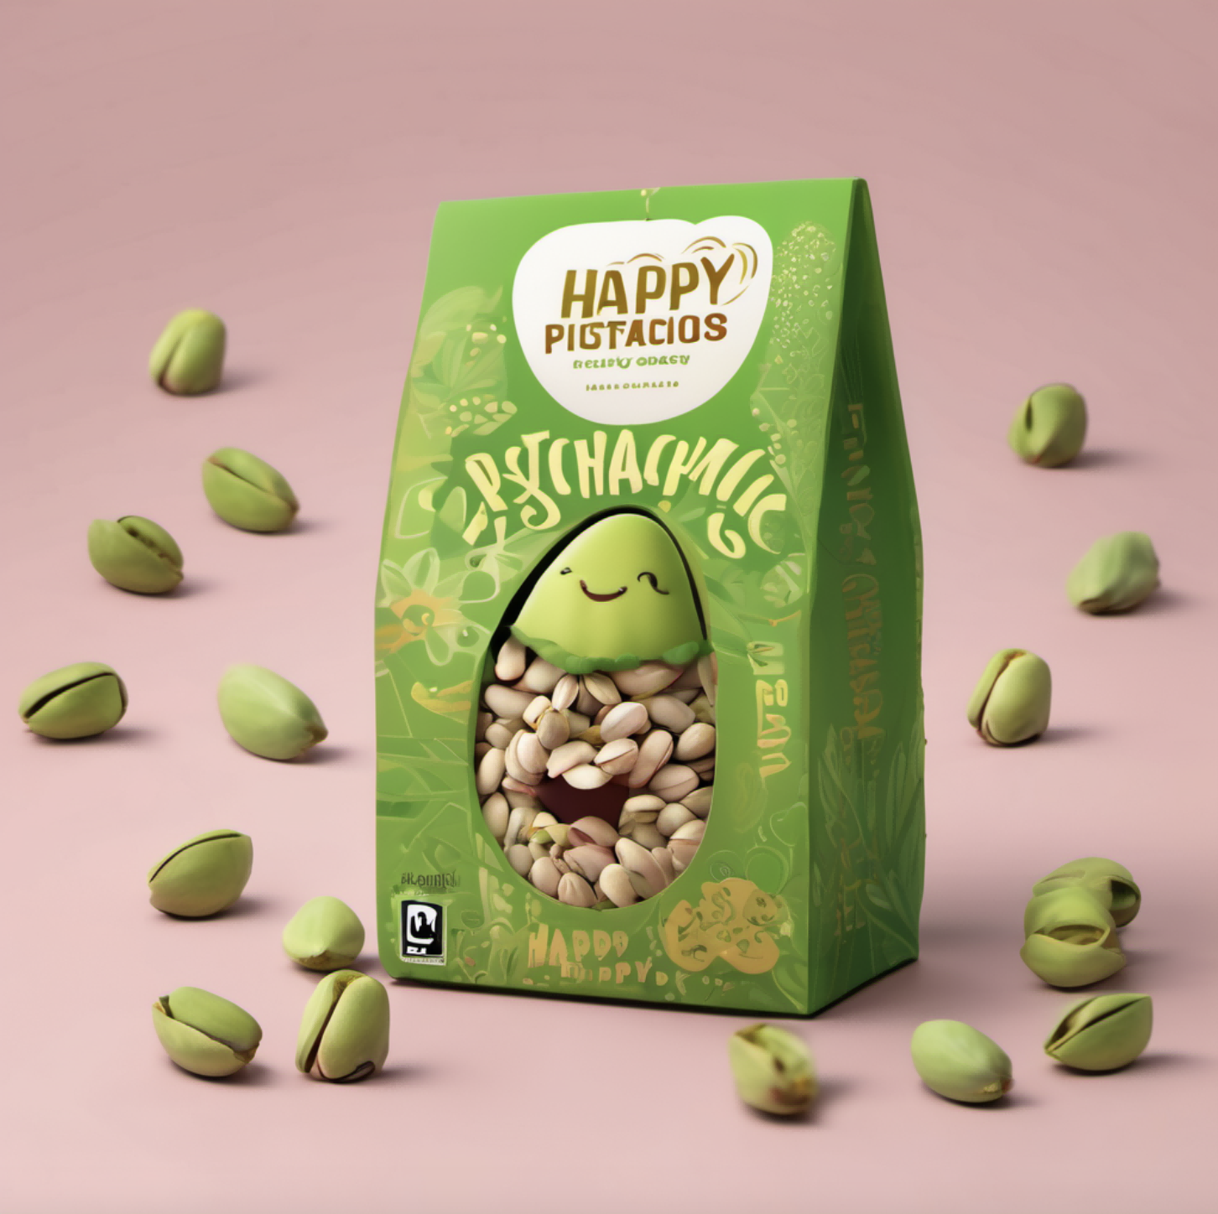
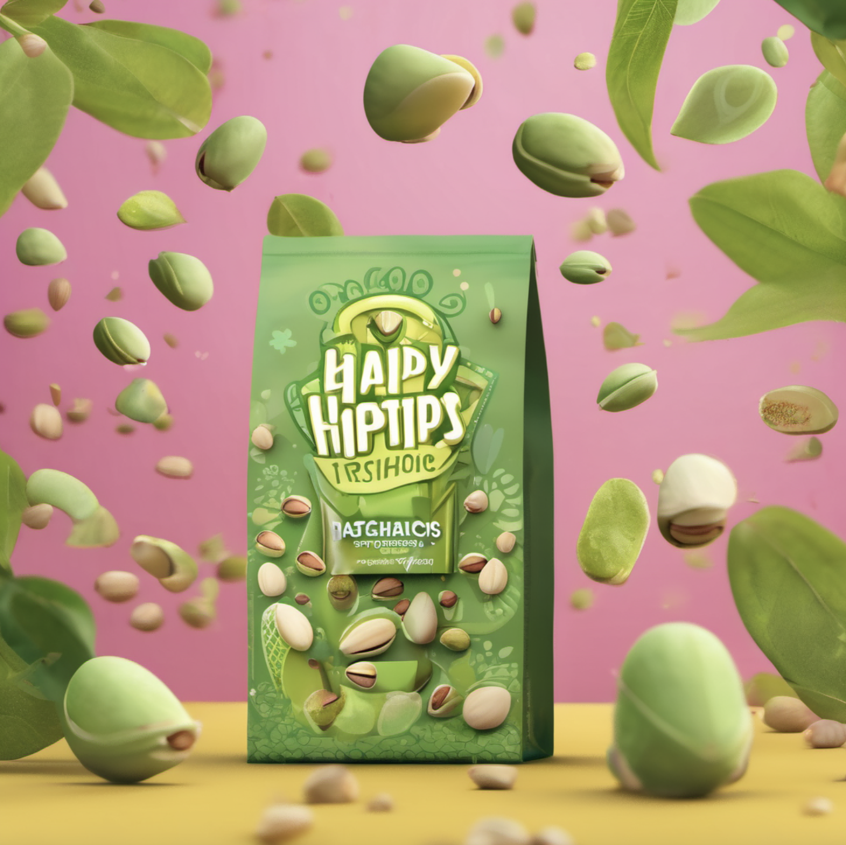
gift Package
octane render (oc渲染器)
octane render (oc渲染器)
tetragonal continuous figure (四方连续图形)

Slide 9
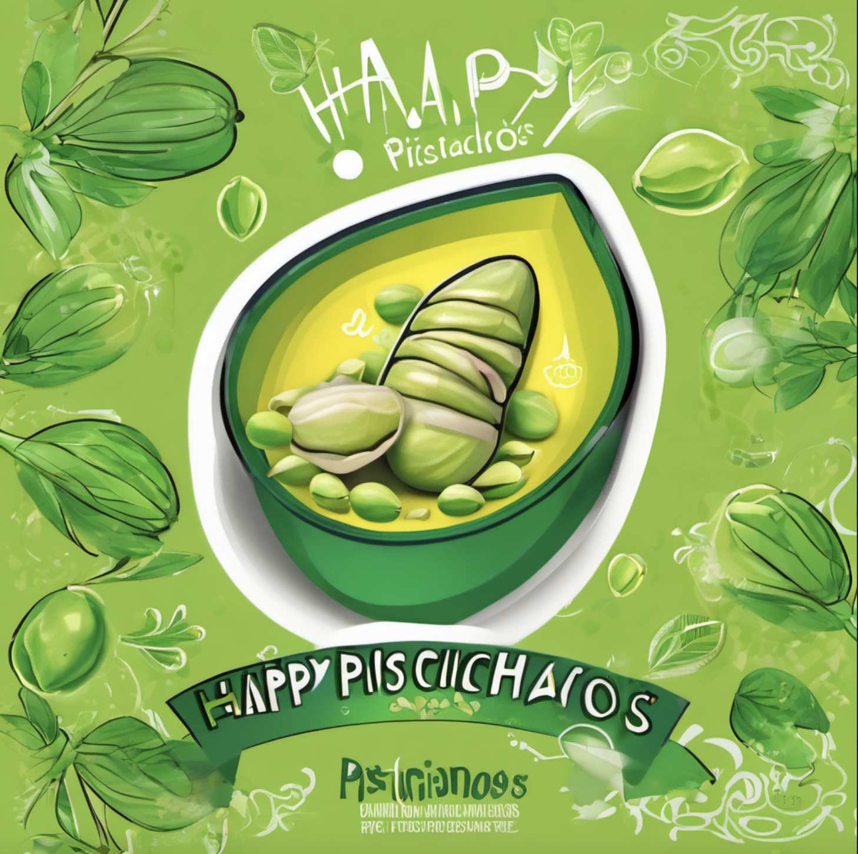
Senlin packing design,pop art,A vibrant and playful design featuring a cheerful pistachio character surrounded by a burst of greenery. The background is adorned with whimsical patterns and the words "Happy Pistachios" in a fun, octane render,inviting font,fourth party continuous designs
Steps: 20, Sampler: DPM++ 2M Karras, CFG scale: 7, Seed: 2557224639, Size: 1024x1024, Model hash: 31e35c80fc, Model: sd_xl_base_1.0, Clip skip: 2, Version: v1.6.0-2-g4afaaf8a

Slide 10
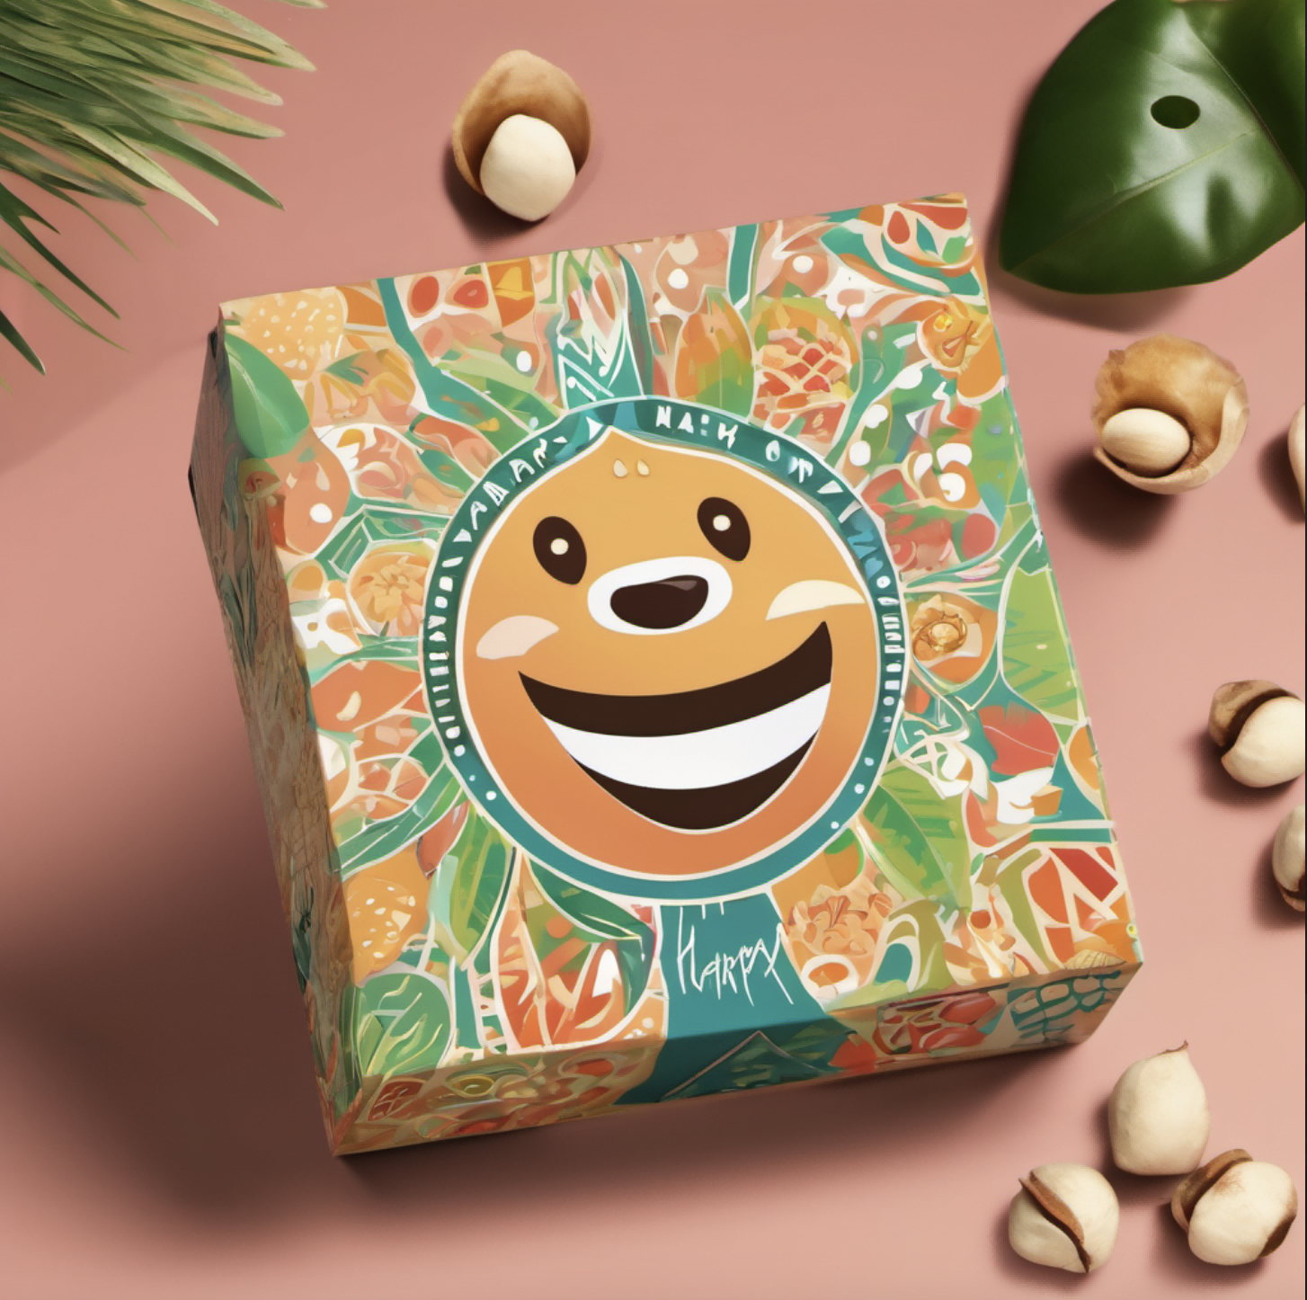
box design,A vibrant and playful design featuring a cheerful macadamia nuts character surrounded by a burst of greenery. The background is adorned with whimsical patterns and the words "Happy" in a fun,inviting font
Steps: 20, Sampler: DPM++ 2M Karras, CFG scale: 7, Seed: 2079253646, Size: 1024x1024, Model hash: 31e35c80fc, Model: sd_xl_base_1.0, Clip skip: 2, Version: v1.6.0-2-g4afaaf8a

Slide 11
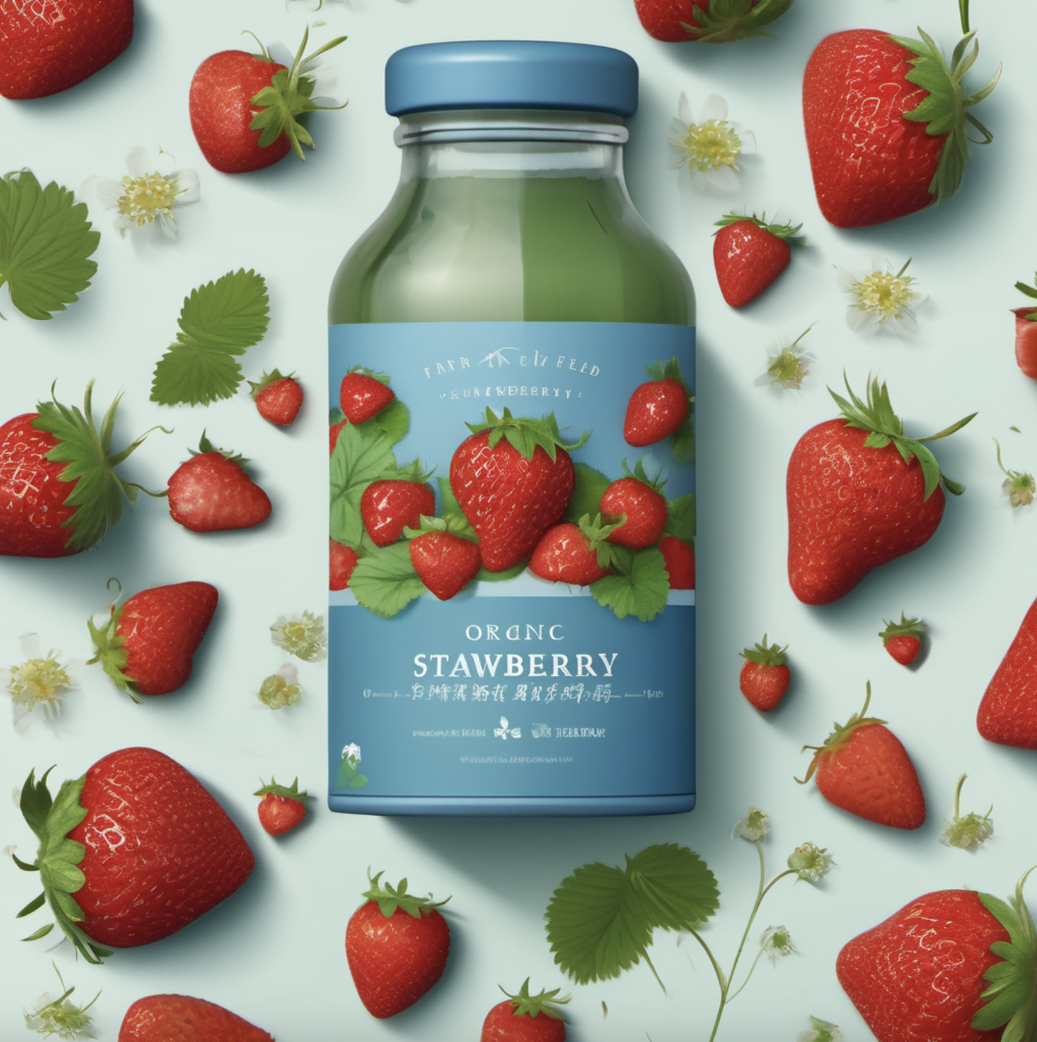
gift package design,An organic farm's strawberry field, showcasing the morning mist and ripe strawberries, highlighting the product's freshness and natural characteristics,Organic farm rural illustration,Fresh and cool colors, such as clear blue, soft green, and bright red, conveying the product's freshness and natural beauty
Steps: 20, Sampler: DPM++ 2M Karras, CFG scale: 7, Seed: 3362842292, Size: 1024x1024, Model hash: 31e35c80fc, Model: sd_xl_base_1.0, Clip skip: 2, Version: v1.6.0-2-g4afaaf8a

Slide 12
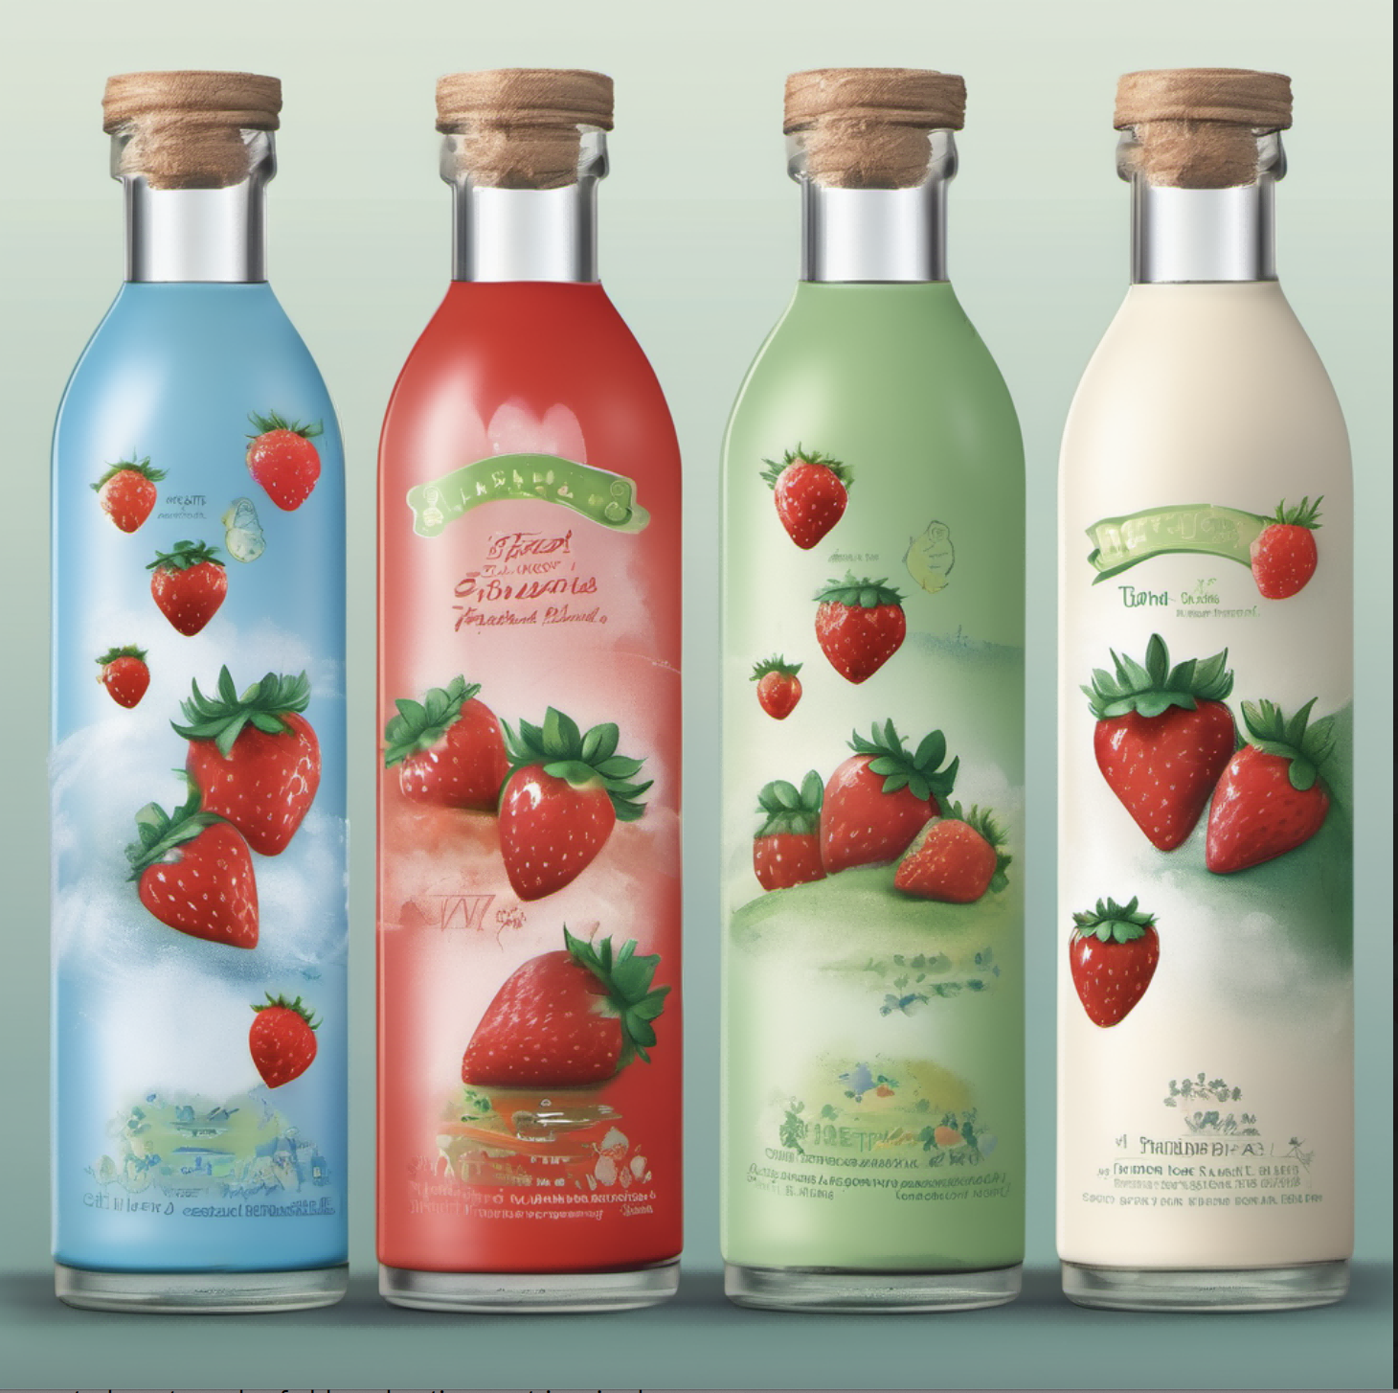
gift package design,A whimsical and artistic design,The bottle showcases a cheerful strawberries character, showcasing the morning mist and ripe strawberries, highlighting the product's freshness and natural characteristics,Organic farm rural illustration,Fresh and cool colors, such as clear blue, soft green, and bright red, conveying the product's freshness and natural beauty
Steps: 20, Sampler: DPM++ 2M Karras, CFG scale: 7, Seed: 155640475, Size: 1024x1024, Model hash: 31e35c80fc, Model: sd_xl_base_1.0, Clip skip: 2, Version: v1.6.0-2-g4afaaf8a

Slide 13
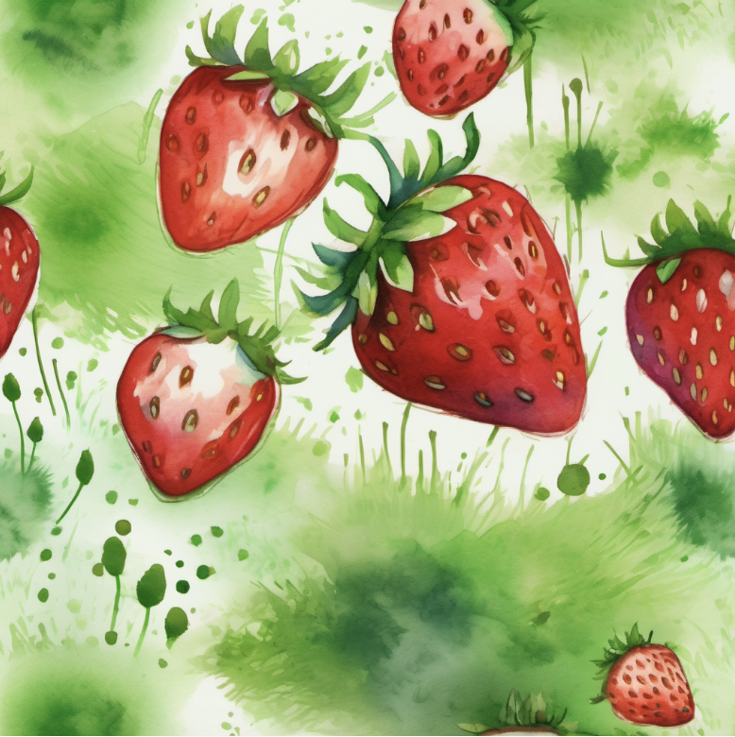
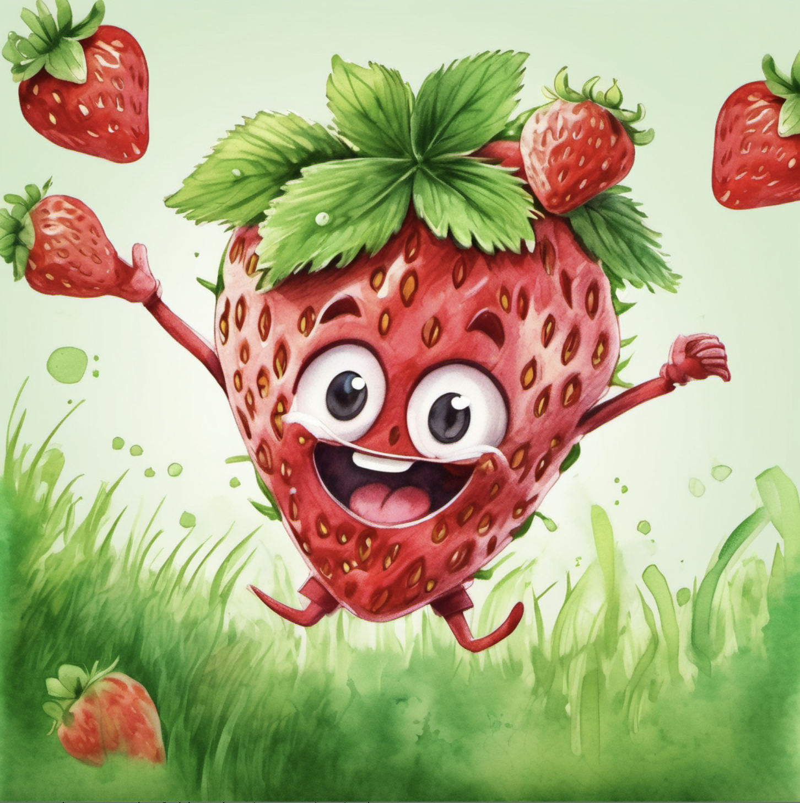
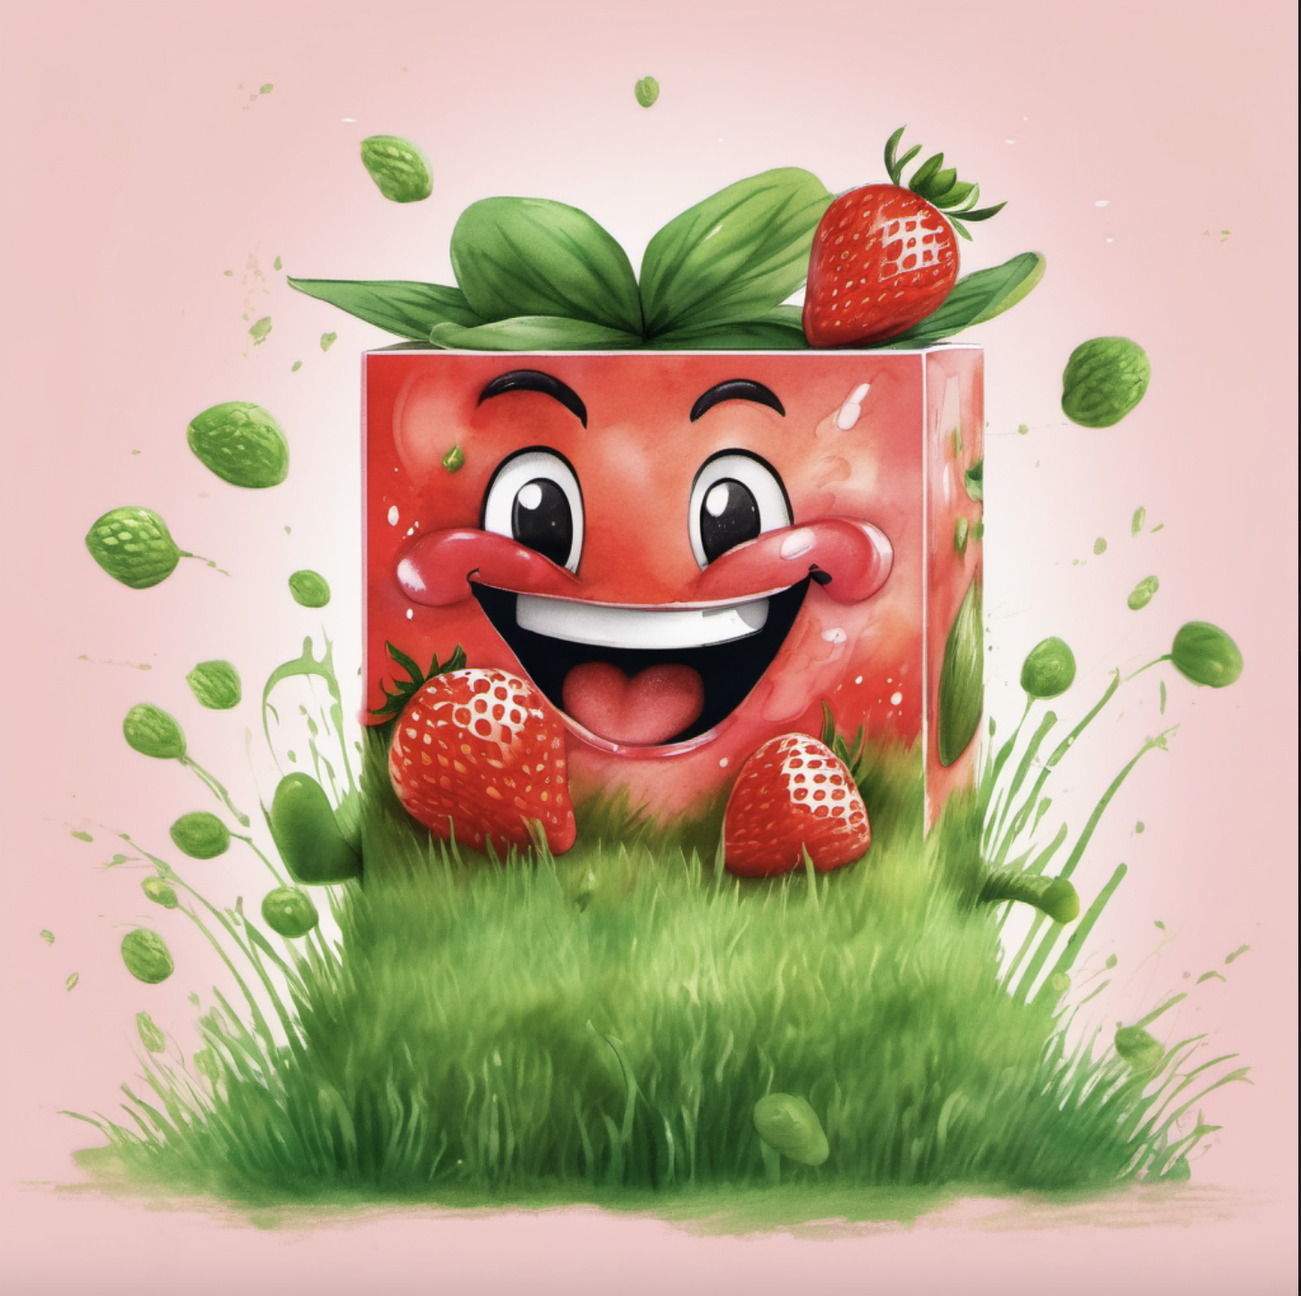
gift package design,A vibrant and playful design featuring a Fresh and energetic strawberries character jumping on the green grass,Hand-drawn watercolor,Mainly strawberry red, with grass green
A vibrant and playful box package design featuring a Fresh and energetic strawberries character jumping on the green grass,Hand-drawn watercolor,Mainly strawberry red, with grass green

Slide 14
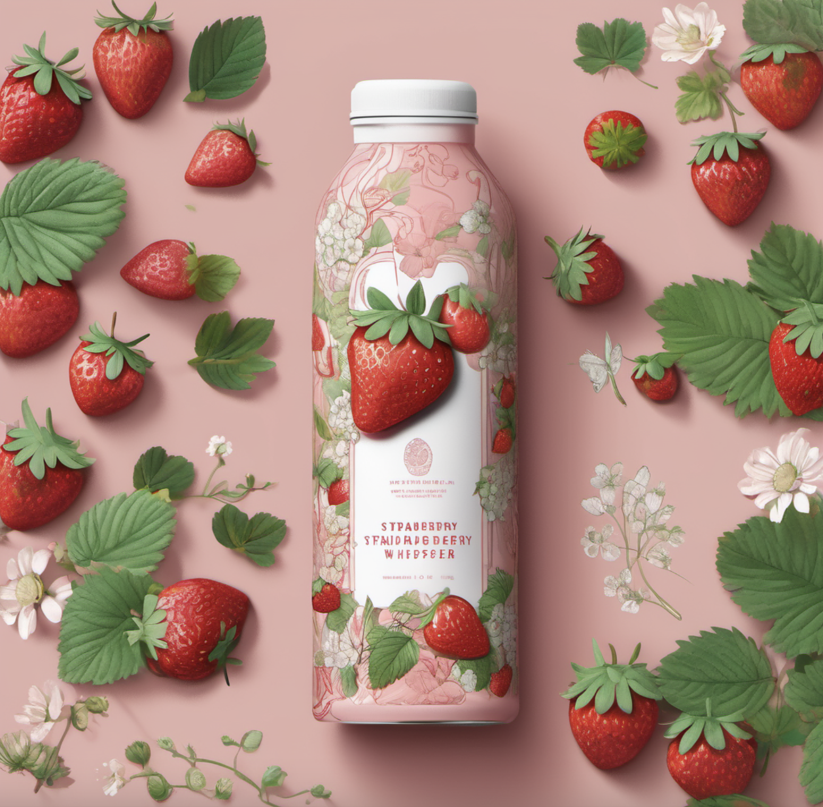
strawberry Whisper,The packaging design concept revolves around the idea that every sip of strawberry juice is an experience of conversing with nature,The imagery depicts strawberries and leaves whispering, surrounded by delicate flowers,The illustration style is characterized by intricate line art. The color palette includes rich strawberry red, soft green, and delicate floral hues
Steps: 20, Sampler: DPM++ 2M Karras, CFG scale: 7, Seed: 698324087, Size: 1024x1024, Model hash: 31e35c80fc, Model: sd_xl_base_1.0, Clip skip: 2, Version: v1.6.0-2-g4afaaf8a

Slide 15
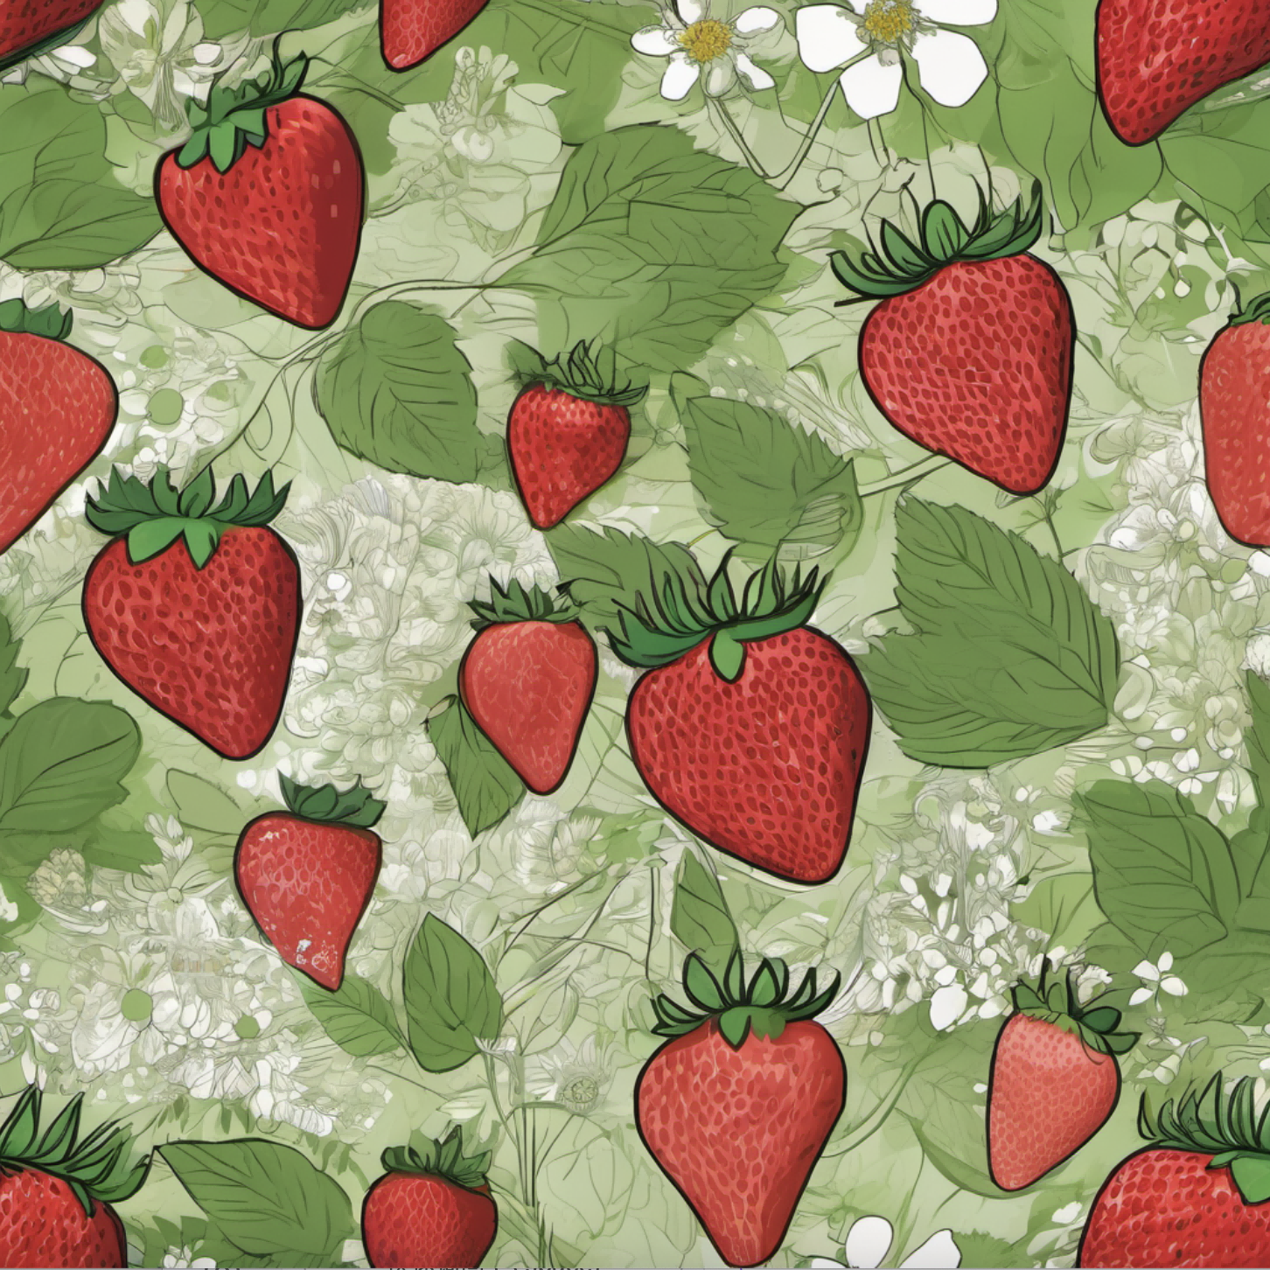
strawberries and leaves whispering, surrounded by delicate flowers, intricate line art,rich strawberry red, soft green, and delicate floral hues, revolves every sip of strawberry juice is an experience of conversing with nature
“草莓密语，画面描述：包装上有草莓和叶子在耳语，周围是细腻的花朵，精细的线条艺术风格，饱满的草莓红、柔和的绿色和淡雅的花色，每一口草莓汁都是一种与自然对话的体验。）
Steps: 20, Sampler: DPM++ 2M Karras, CFG scale: 7, Seed: 391706261, Size: 1024x1024, Model hash: 31e35c80fc, Model: sd_xl_base_1.0, Clip skip: 2, Version: v1.6.0-2-g4afaaf8a

Slide 16
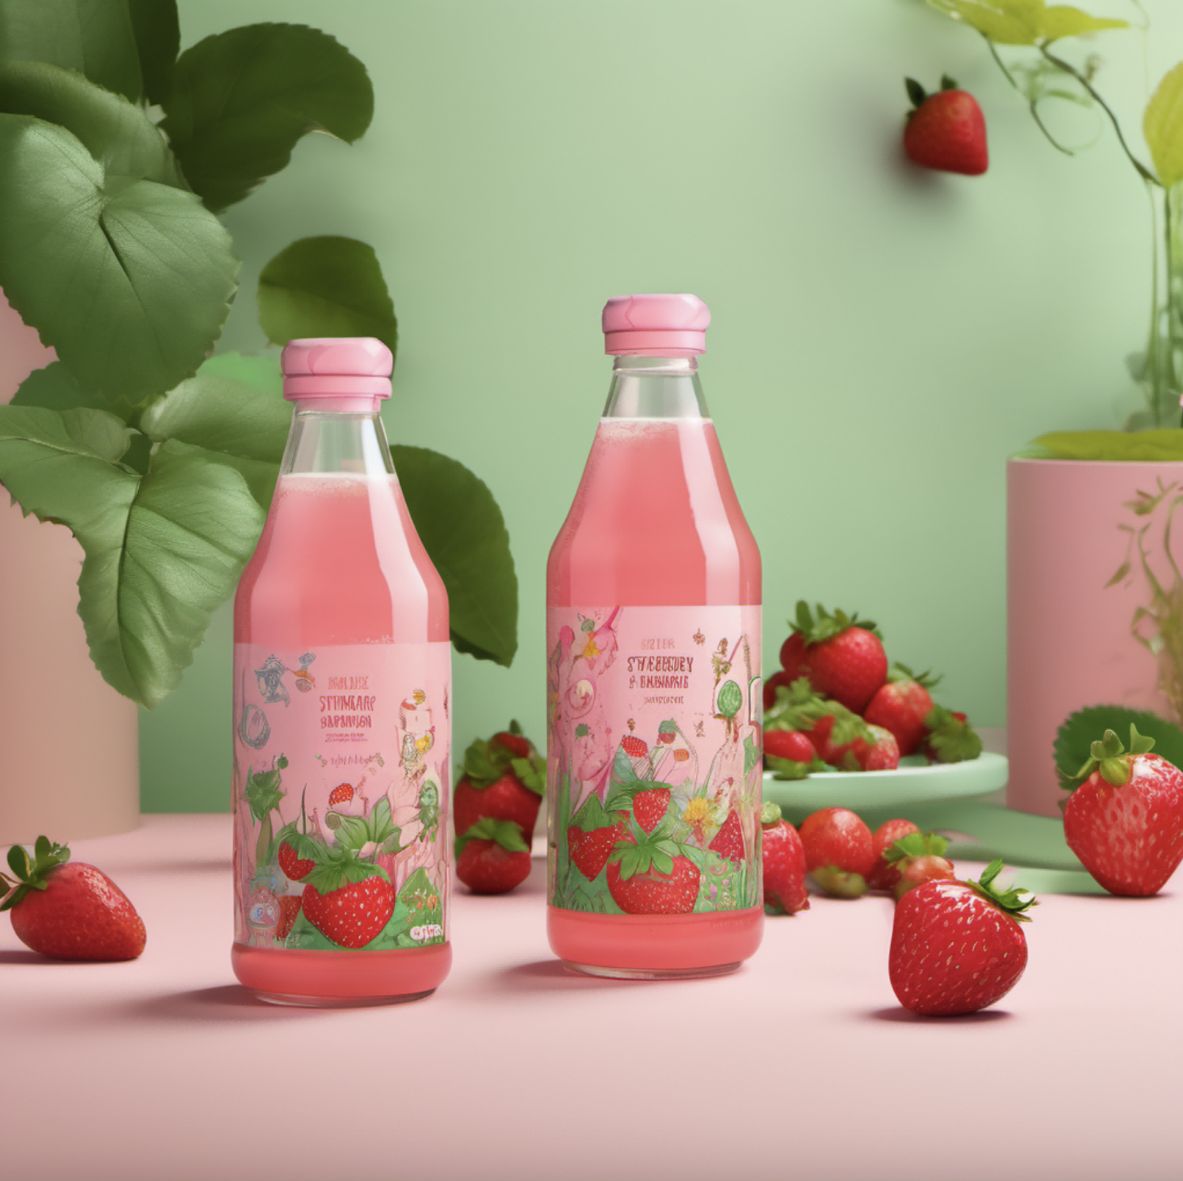
Packaging Design,the experience of drinking strawberry juice is likened to entering an imaginative fairy tale world,The packaging features a dreamy strawberry tree surrounded by fantastical creatures and plants,Cartoon style, with a sense of childlike wonder and fantasy colors, Soft pink, bright green, and warm sunshine yellow
Steps: 20, Sampler: DPM++ 2M Karras, CFG scale: 7, Seed: 2352272367, Size: 1024x1024, Model hash: 31e35c80fc, Model: sd_xl_base_1.0, Clip skip: 2, Version: v1.6.0-2-g4afaaf8a

Slide 17
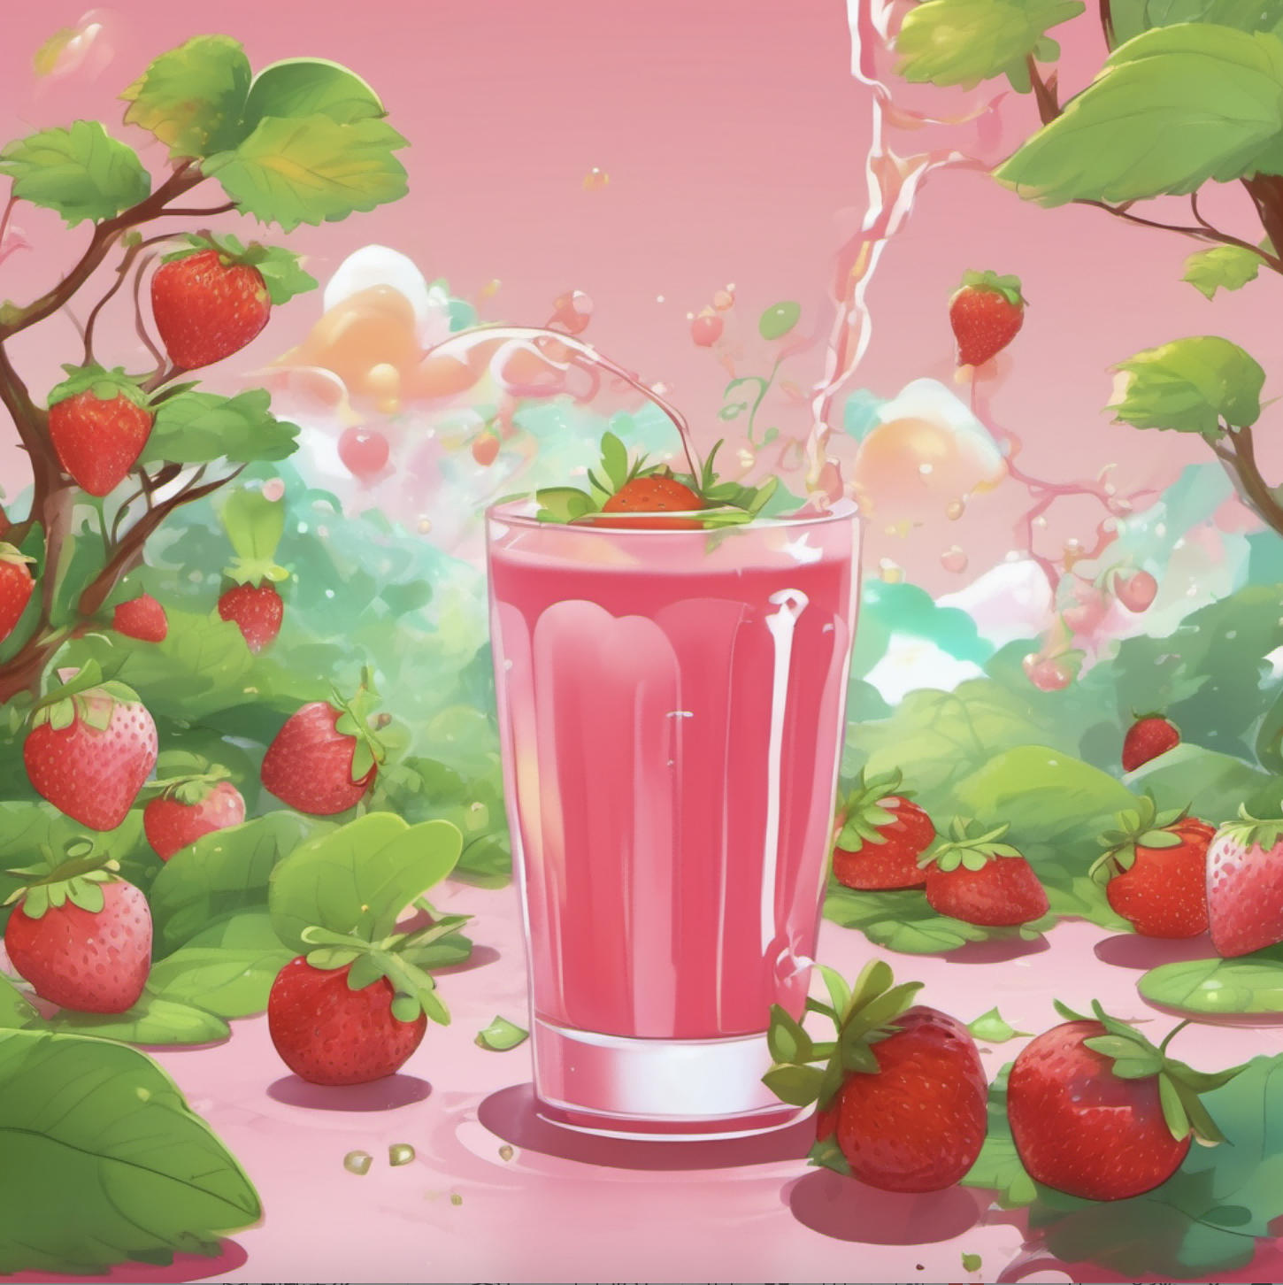
the experience of drinking strawberry juice is likened to entering an imaginative fairy tale world,a dreamy strawberry tree surrounded by fantastical creatures and plants,Cartoon style, with a sense of childlike wonder and fantasy colors, Soft pink, bright green, and warm sunshine yellow

Slide 18
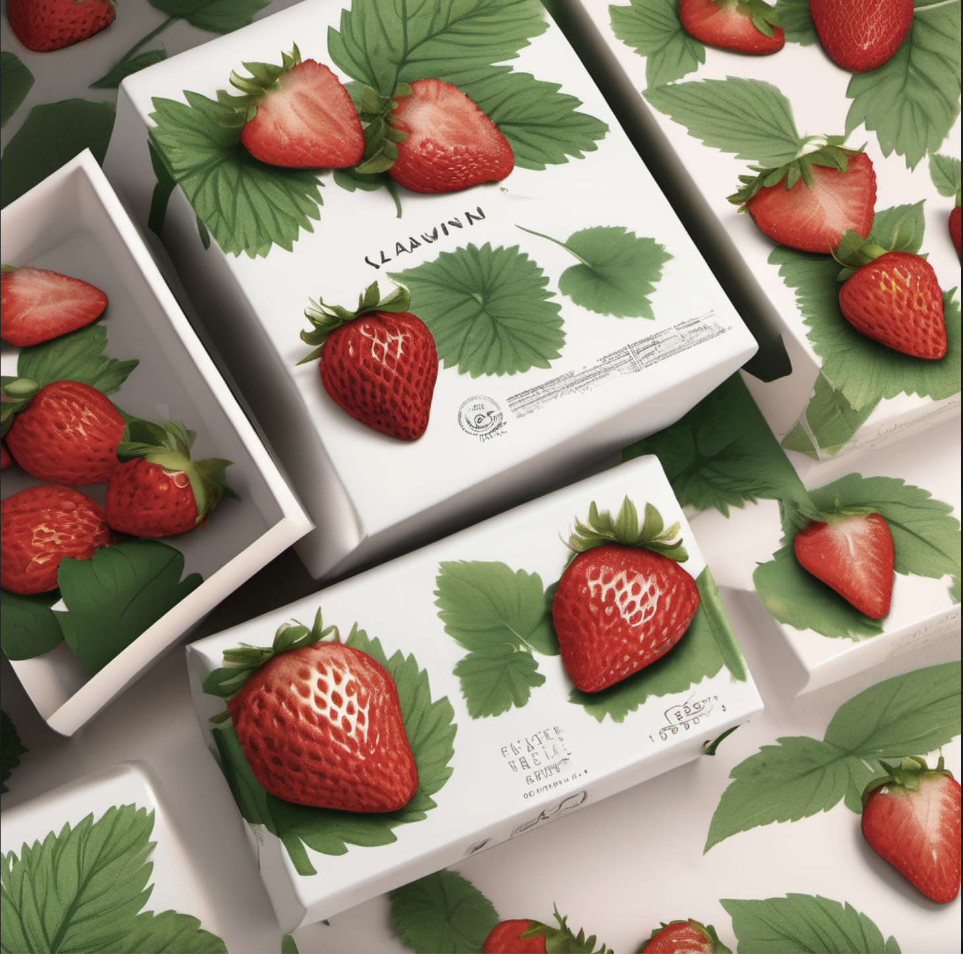
packaging design,A beautifully illustrated strawberry and leaves design,The strawberry is realistically detailed and features leaves whispering around it. The illustration is in a naturalistic style with a focus on texture and depth. The color palette is bright and vibrant, with a focus on reds and greens. The package design is eye-catching and appealing, with a high-end feel. The packaging is made of eco-friendly materials and features a premium finish. The design is minimalist and modern, with a focus on simplicity and elegance

